Slide 1


Subject Name :Wireless Networks Presentation Title: 4G Technology and its evolution
JEPPIAAR INSTITUTE OF TECHNOLOGY
“Self-Belief | Self Discipline | Self Respect”
Department of Electronics and communication Engineering
Team Members:
Students Name Reg.No:
1. Jagadisan S 210617106042
2. Sudakar V 210617106076
3. Campell S 210617106020
4. Ajith Kumar M 210617106004
5. Charmathi K 210617106021
6. Dharini D 210617106023

Slide 2
OBJECTIVE
so.. Review will be conducted as per schedule.
To learn more about the evolution of generations and to get clear about the 4G technology over other technologies.

Slide 3
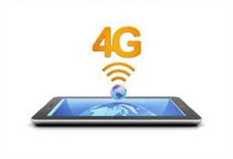
4G TECHNOLOGY
so.. Review will be conducted as per schedule.
TECHNICAL DETAILS
4G LTE which means fourth generation long term evolution.
It aims to offer the users faster , more reliable mobile broadband internet for the devices such as the smartphones , the tablets & the laptops.
Its speed is much more faster than the 3G.
The 4G can reach 100Mbps , 150Mbps and 300Mbps.
In future will update to 1000Mbps.
4G network theoretically will have a
higher data transfer rate over 3G
networks.

Slide 4
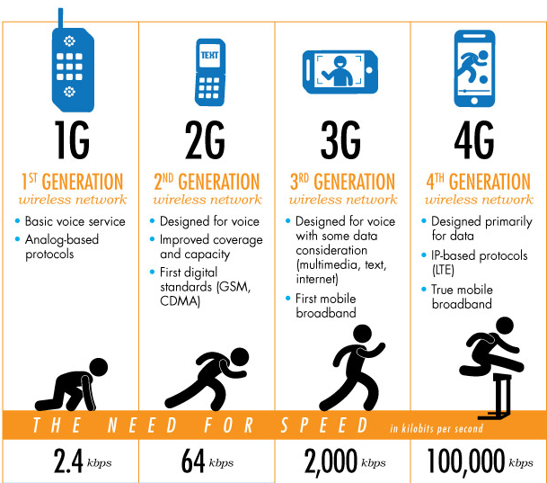
OBJECTIVE
so.. Review will be conducted as per schedule.
EVOLUTION
TECHNICAL DETAILS
To learn more about 4G technology, its features, applications , advantages, disadvantages and some more.

Slide 5
ADVANTAGES OF 4G
TECHNICAL DETAILS
TECHNICAL DETAILS
Quickly download files over a wireless network
Extremely high voice quality
Easily access Internet, IM, social networks, streaming media, video calling
Higher bandwidth
4G is 10 times faster than 3G

Slide 6
DISADVANTAGES OF 4G
TECHNICAL DETAILS
so.. Review will be conducted as per schedule.
New frequencies means new components in cell towers.
Higher data prices for consumers
Consumer is forced to buy a new device to support the 4G
It is impossible to make your current equipment compatible with the 4G network

Slide 7
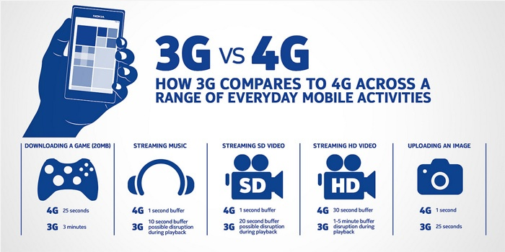

Slide 8
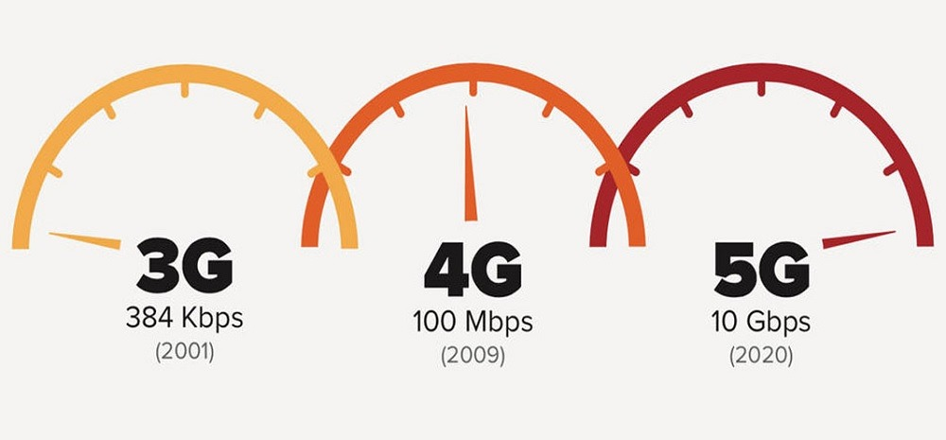
How Fast is 4G?
TECHNICAL DETAILS
so.. Review will be conducted as per schedule.
Standard 4G offers download speeds of around 14 Mbps, which is five times faster than the 3G network.
4G networks can reach to150 Mbps, allowing users to download gigabytes of data in minutes or even seconds, instead of hours like with 3G networks.
Uploading data is much faster as well –4G provides 8 Mbps and reaching as high as 50 Mbps, while provides 0.5 Mbps.

Slide 9
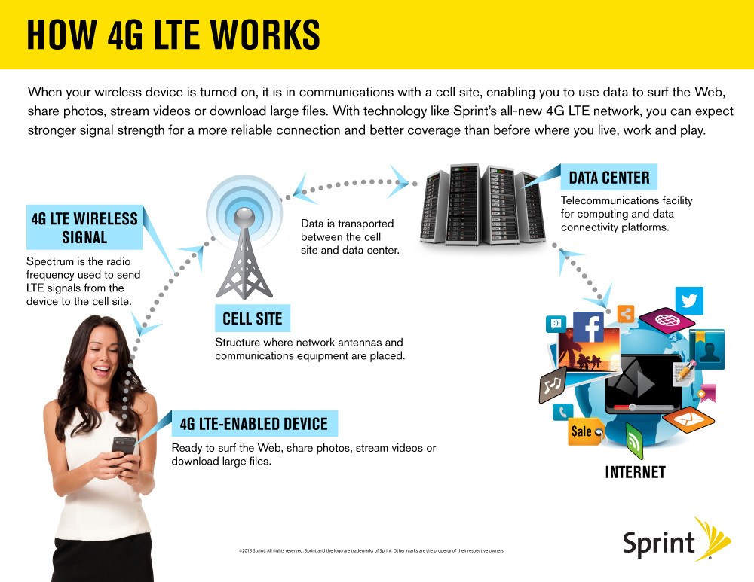

Slide 10
FUTURE SCOPE
TECHNICAL DETAILS
Forecasts predict that in the next few years the global 4G data transfer network will increase in size by 23 times and will account for 81% of mobile traffic.
The requirement for faster and more stable levels of connectivity is growing due to the demand of applications that rely on constantly transferring data.
Many applications need to be able to communicate in real-time, therefore relying on a strong network connection that will remain intact while moving around between locations.

Slide 11
Reference
https://www.online-sciences.com/technology/4g-technology-uses-features-advantages-and-disadvantages/
https://www.quora.com/What-are-the-advantages-and-disadvantages-of-4G-technology
https://www.gmv.com/blog_gmv/language/en/market-importance-4g/

Slide 12
Thank You

