Slide 1

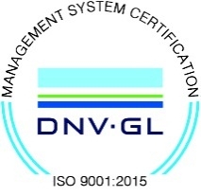
Subject Name :Wireless Networks Presentation Title: 5G Technology
JEPPIAAR INSTITUTE OF TECHNOLOGY
“Self-Belief | Self Discipline | Self Respect”
Department of Electronics and communication Engineering
Team Members:
Students Name Reg.No:
1.Asfiya naaz A.I 210617106011
2.Avil anisha .A 210617106012
3.Thilotaman.p 210617106080
4.Saravana Kumar 210617106071
5.pradeep.S 210617106059
6.Murali.S 210617106054

Slide 2
CONTENT
ABSTRACT
INTRODUCTION
HISTORY(1G,2G,3G,4G)
WHAT IS 5G
ARCHITECTURE
COMPARISON OF 3G,4G&5G
APPLICATIONS
REFERENCE

Slide 3
OBJECTIVE
5G Technology stands for 5th Generation mobile technology
5G technology has changed the means to use cell phones within very high bandwidth
5G technology most powerful and in huge demand in near future

Slide 4
INTRODUCTION
The word wireless is defined as “having no wires”
In networking terminology,wireless is the term used to describe any computer network where there is no physical wired connection between sender and receiver,but rather it is connected by radio waves and or microwaves to maintain communications

Slide 5
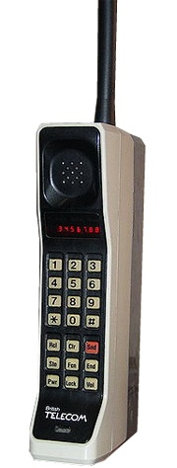
HISTORY OF 1G
1G refers to the first generation of wirelesss telephone mobile telecommunication which was first introduced in 1980s and completed in early 1990s.
Its speed was up to 2.4kbps
1G network use analog signal
AMPS was first launced in USA

Slide 6
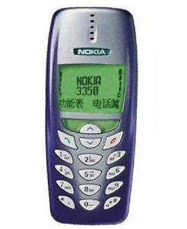
HISTORY OF 2G
It was launched in Finland in 1991.
2G network use digital signal
Its data speed was upto 64kbps
2G refers to 2nd Generation based on GSM
Features such as messages,picture messages and MMS

Slide 7
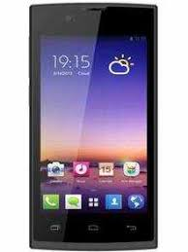
HISTORY OF 3G
3G Technology refers to 3rd Generation which was introduced in the year 2000
Data transmission speed increased from
144kbps to 2Mbps Typically called smart phones
And features increased its bandwidth and
data transfer rate to accommodate web based
application and audio ,video files

Slide 8
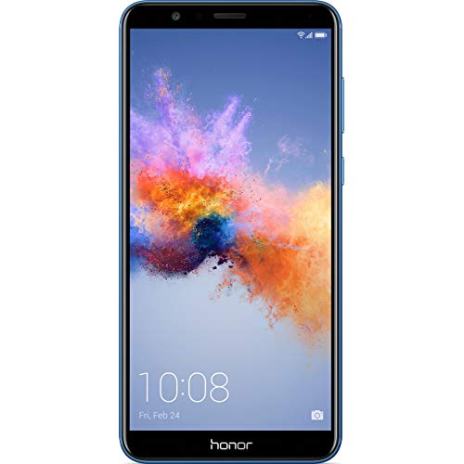
HISTORY OF 4G
4G Technology refers to 4th Generation which was started from late 2000s
Capable of providing 100 Mbps to 1Gbps speed
Features such as more security ,high speed, low cost per-bit etc.

Slide 9
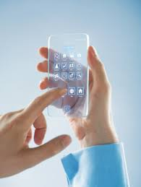
HISTORY OF 5G
5G technology refers to 5th Generation which was started from late 2010s
Complete wireless communication with no limitations
It is highly supportable to WWWW(Wireless world wide web)
Benefits such as high speed high capacity,faster data tranmission than previous
Its is more effective and attractive

Slide 10
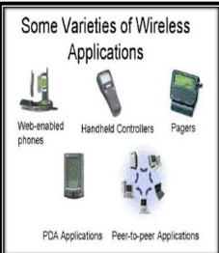
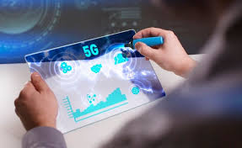
APPLICATIONS
Wireless applications are this which we use free space as the transmission medium &do not involve cabling like fiber or copper cables

Slide 11
REFERENCE
http://www.ieee.com/explorer
http://www.hubpages.com

Slide 12
Thank you

