Slide 1


Subject Name : MICROPROCESSOR AND MICROCONTROLLER
Presentation Title: Applications of 8051 microprocessor in agriculture
JEPPIAAR INSTITUTE OF TECHNOLOGY
“Self-Belief | Self Discipline | Self Respect”
Department of Computer Science and Engineering
Team Members:
Students Name Reg.No:
1. Kalaiselvi 210617106044
2. Mahalakshmi 210617106052
3. Ajith 210617106003
4. Giri Prasath 210617106032
5. Ramakrishnan 210617106068
6. Pravin 210617106060

Slide 2
Objective
To discuss about the applications of 8051 microprocessor in agriculture mainly in irrigation process
To make simple and convenient methods in irrigation we need to go for 8051 microprocessor

Slide 3
INTRODUCTION
A model of controlling irrigation facilities to help millions of people. This model uses sensor technology with microcontroller to make a smart switching device .
The model shows the basic switching mechanism of Water motor using sensors from any part of field by sensing the motor using sensors from any part of field by sensing the moisture present in the soil

Slide 4
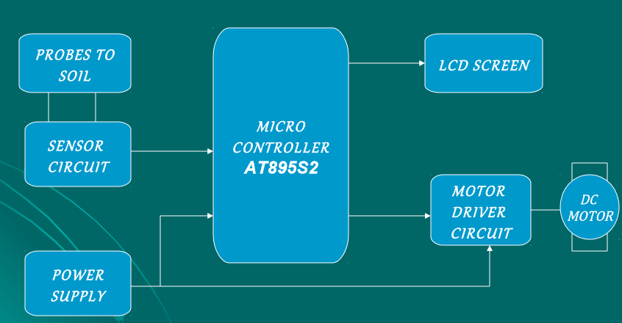
Block Diagram

Slide 5
Technical Details
WORKING:
It consists three circuits namely sensor circuit, microcontroller and motor sensor circuit, microcontroller and motor driver circuit
Sensor circuit senses the condition of soil and compares the voltage with the reference voltage i.e.,5v this is done by the IC timer 555.

Slide 6
Technical Details
The condition of motor and soil are displayed in the LCD screen .

Slide 7
Technical Details
APPLICATIONS :
Irrigation In Fields.
Irrigation In Gardens, Parks.
Very Efficient For Paddy, Rice Fields.
Picsiculture

Slide 8
Technical Details
MERIT:
Highly sensitive, Low cost and reliable circuit.
Works according to the soil condition.
Complete elimination of manpower.
Can handle heavy loads up to 7A.
System can be switched into manual mode whenever required.

Slide 9
Technical Details
DEMERIT :
This is applicable for only large farms.
Have limited life after installation due to the detoriation plastic component in a hot, arid climate when exposed to ultraviolet light

Slide 10
Result & Discussion
In present days especially farmers are facing major problems in watering their agriculture fields, it’s because they have no proper idea about when the power is available so that they can pump water. Even after then they need to wait until the field is properly watered, which makes them to stop doing other activities. Here is an idea which helps not only farmers even for watering the gardens also, which senses the soil moisture and switches the pump automatically when the power is ON.

Slide 11
Future Scope
The working is basically dependent on the output of the humidity sensors. Whenever there is need of excess water in the desired field(RICE crops) then it will not be possible by using sensor technology. For this we will using sensor technology. By using this we will be able to irrigate the desired field & in desired amount.

Slide 12
Reference
Book Authors
Kenneth J. Ayala
Dhananjay V. Gadre
Anurag Chugh
https//www.aplications of 8051 microcontroller.com

