Slide 1

Subject: Microprocessor and Microcontroller
Title: Automated water sprinkler using 8086 microprocessor
JEPPIAAR INSTITUTE OF TECHNOLOGY
“Self-Belief | Self Discipline | Self Respect”
Department Of Electronics And Communication Engineering
Team Members:
Students Name
1. Jagadisan S
2. Sudakar V
3. Campell S
4. Ajith Kumar M
5. Charmathi K
6. Dharini D
Reg No:
210617106042
210617106076
210617106020
210617106004
210617106021
210617106023

Slide 2
OBJECTIVE
To design a simple and exciting automatic plant watering system using 8086 microprocessor.

Slide 3
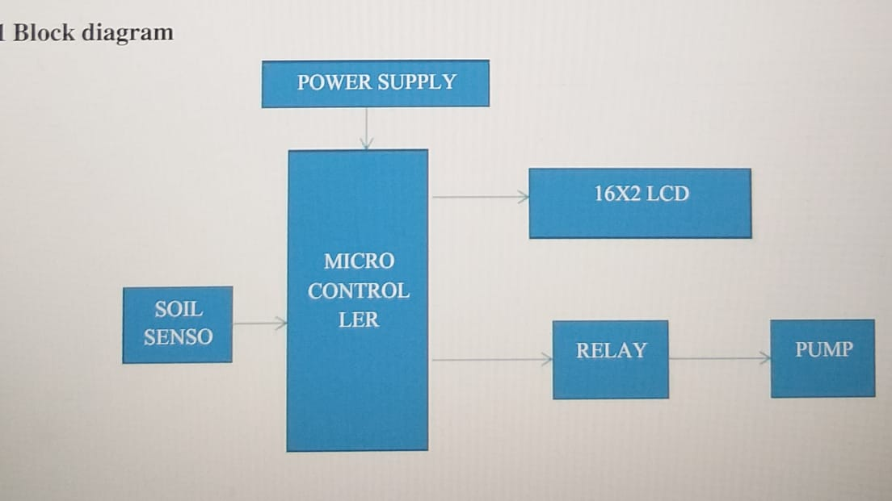
BLOCK DIAGRAM OF AUTOMATIC WATERING SYSTEM
Pay 6000 fee also.. Review will be conducted as per schedule.partial output, 2 chapters of the report ( abstract, Introduction, Literature Review) without fail.
Pay 6000 fee also.. Review will be conducted as per schedule.

Slide 4
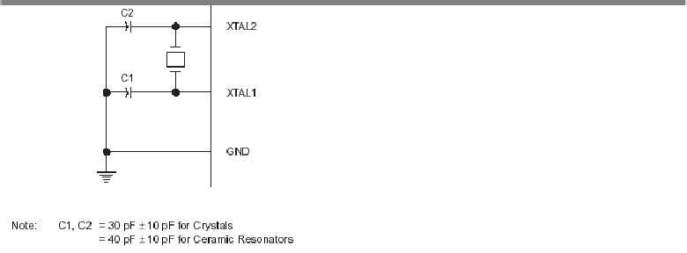
LCD (Liquid Crystal Diode)
A liquid crystal display (LCD) is a thin, flat display device made up of any number of color ormonochrome pixels arrayed in front of a light source or reflector. Each pixel consists of a columnof liquid crystal molecules suspended between two transparent electrodes, and two polarizingfilters, the axes of polarity of which are perpendicular to each other. Without the liquid crystals between them, light passing through one would be blocked by the other. The liquid crystal twiststhe polarization of light entering one filter to allow it to pass through the other.
Features
(1)
Interface with either 4-bit or 8-bit microprocessor.(2)
Display data RAM(3) Character generator ROM
AUTOMATIC WATER GARDENING SYSTEM
Dept of ECE,ATRI Page no-13(4). 160 different 5 7 dot-matrix character patterns.(5) Numerous instructions(6).Clear Display, Cursor Home, Display ON/OFF, Cursor ON/OFF ,Blink Character,Cursor Shift, Display Shift.(7) Built-in reset circuit is triggered at power ON.(8). Built-in oscillator
A liquid crystal display (LCD) is a thin, flat display device made up of any number of color or monochrome pixels arrayed in front of a light source or reflector. Each pixel consists of a column of liquid crystal molecules suspended between two transparent electrodes, and two polarizing filters, the axes of polarity of which are perpendicular to each other. Without the liquid crystals between them, light passing through one would be blocked by the other. The liquid crystal twists the polarization of light entering one filter to allow it to pass through the other
Features
Interface with either 4-bit or 8-bit microprocessor.(2)
Display data RAM
Character generator ROM
160 different 5 7 dot- matrix character patterns.
Numerous instructions
Clear Display, Cursor Home, Display ON/OFF, Cursor ON/OFF ,Blink Character,Cursor Shift, Display Shift.
Built-in reset circuit is triggered at power ON.
Built-in oscillator.

Slide 5
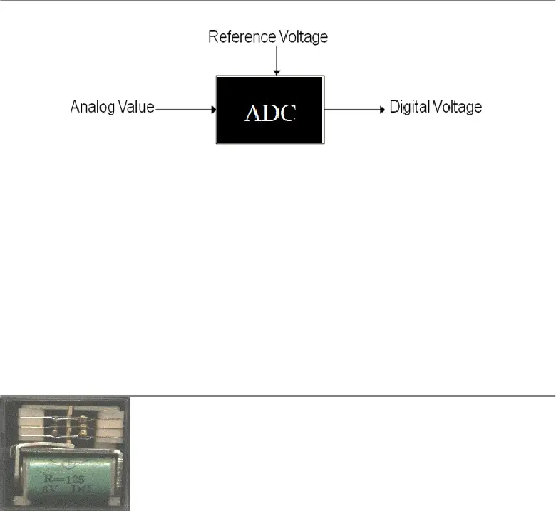
TECHNICAL DETAILS
RELAYS
A liquid crystal display (LCD) is a thin, flat display device made up of any number of color ormonochrome pixels arrayed in front of a light source or reflector. Each pixel consists of a columnof liquid crystal molecules suspended between two transparent electrodes, and two polarizingfilters, the axes of polarity of which are perpendicular to each other. Without the liquid crystals between them, light passing through one would be blocked by the other. The liquid crystal twiststhe polarization of light entering one filter to allow it to pass through the other.
Features
(1)
Interface with either 4-bit or 8-bit microprocessor.(2)
Display data RAM(3) Character generator ROM
AUTOMATIC WATER GARDENING SYSTEM
Dept of ECE,ATRI Page no-13(4). 160 different 5 7 dot-matrix character patterns.(5) Numerous instructions(6).Clear Display, Cursor Home, Display ON/OFF, Cursor ON/OFF ,Blink Character,Cursor Shift, Display Shift.(7) Built-in reset circuit is triggered at power ON.(8). Built-in oscillator
A relay is an electrical switch that opens and closes under the control of another electrical circuit.In the original form, the switch is operated by an electromagnet to open or close one or many setsof contacts. A relay is able to control an output circuit of higher power than the input circuit, it can be considered to be, in a broad sense, a form of an electrical amplifier.

Slide 6
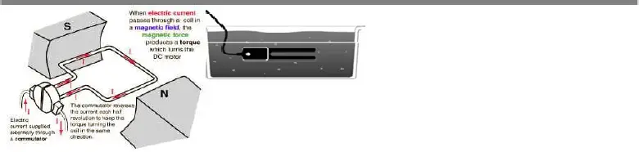
TECHNICAL DETAILS
SOIL SENSOR
A liquid crystal display (LCD) is a thin, flat display device made up of any number of color ormonochrome pixels arrayed in front of a light source or reflector. Each pixel consists of a columnof liquid crystal molecules suspended between two transparent electrodes, and two polarizingfilters, the axes of polarity of which are perpendicular to each other. Without the liquid crystals between them, light passing through one would be blocked by the other. The liquid crystal twiststhe polarization of light entering one filter to allow it to pass through the other.
Features
(1)
Interface with either 4-bit or 8-bit microprocessor.(2)
Display data RAM(3) Character generator ROM
AUTOMATIC WATER GARDENING SYSTEM
Dept of ECE,ATRI Page no-13(4). 160 different 5 7 dot-matrix character patterns.(5) Numerous instructions(6).Clear Display, Cursor Home, Display ON/OFF, Cursor ON/OFF ,Blink Character,Cursor Shift, Display Shift.(7) Built-in reset circuit is triggered at power ON.(8). Built-in oscillator
Measure the loss of moisture over time due to evaporation and plant uptake.
Evaluate optimum soil moisture contents for various species of plants.
Monitor soil moisture content to control irrigation in greenhouses.
The entire sensor can be placed vertically, but because soil moisture often varies by depth, thisis not usually the desired orientation. To position the sensor, use a thin implement such as a trenching shovel to make a pilot hole in the soil. Place the sensor into the hole, making sure the entire length of the sensor is covered. Press down on the soil along either side of the sensor with your fingers

Slide 7
TECHNICAL DETAILS
DC MOTOR
A liquid crystal display (LCD) is a thin, flat display device made up of any number of color ormonochrome pixels arrayed in front of a light source or reflector. Each pixel consists of a columnof liquid crystal molecules suspended between two transparent electrodes, and two polarizingfilters, the axes of polarity of which are perpendicular to each other. Without the liquid crystals between them, light passing through one would be blocked by the other. The liquid crystal twiststhe polarization of light entering one filter to allow it to pass through the other.
Features
(1)
Interface with either 4-bit or 8-bit microprocessor.(2)
Display data RAM(3) Character generator ROM
AUTOMATIC WATER GARDENING SYSTEM
Dept of ECE,ATRI Page no-13(4). 160 different 5 7 dot-matrix character patterns.(5) Numerous instructions(6).Clear Display, Cursor Home, Display ON/OFF, Cursor ON/OFF ,Blink Character,Cursor Shift, Display Shift.(7) Built-in reset circuit is triggered at power ON.(8). Built-in oscillator
A DC motor is designed to run on DC electric power. Two examples of pure DC designs areMichael Faraday's homopolar motor (which is uncommon), and the ball bearin motor, which is (sofar) a novelty. By far the most common DC motor types are the brushed and brushless types, whichuse internal and external commutation respectively to create an oscillating AC current from theDC source -- so they are not purely DC machines in a strict sense

Slide 8
TECHNICAL DETAILS
CIRCUIT WORKING
Pay 6000 fee also.. Review will be conducted as per schedule.partial output, 2 chapters of the report ( abstract, Introduction, Literature Review) without fail.
Pay 6000 fee also.. Review will be conducted as per schedule.
When the soil is dry then there would be high resistance which will allow the flow of current and transistor T2 will get switch on, this will let the current flow towards the diode and thus relay will get switch on. When the relay gets switched on, 230V current will be supplied to water pump and water will be supplied to the plants. As soon as soil gets wet; two probes of the circuit will conduct electricity due to presence of the ions in the soil and soon transistor T1 will get switch on due to low resistance between probes, thus switches off the pump and water supply to be stopped. The circuit is also consists of a variable resistor through which sensitivity of probes can be adjusted.

Slide 9
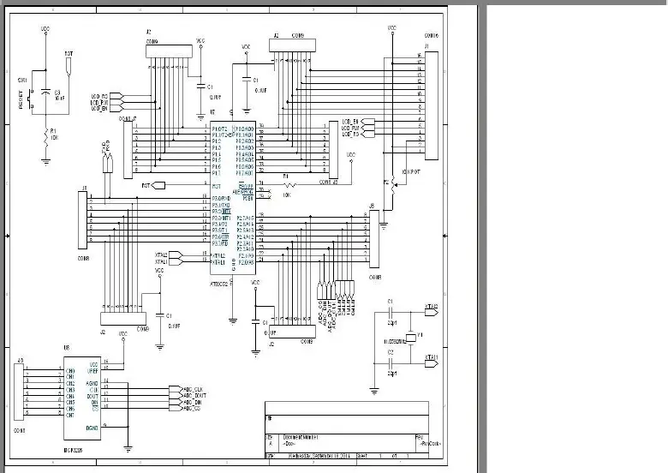
TECHNICAL DETAILS
CIRCUIT DIAGRAM

Slide 10
TECHNICAL DETAILS
SOFTWARE IMPLEMENTATION
The software used here is commonly called as Keil software

Slide 11
TECHNICAL DETAILS
APPLICATIONS
Irrigation in fields, park, garden
It is a picsiculture
Very efficient for paddy fields
ADVANTAGES
Work according to the soil condition
High efficient , low cost
Automatically motor will be on

Slide 12
FUTURE SCOPE
TECHNICAL DETAILS
This smart irrigation system extends watering time for plants, and provides ideal growth condition. It saves time and timer delay as per the environmental condition can be added for automatic watering. This smart irrigation system can be adjusted and modified according to the changing environment

Slide 13
REFERENCE
https://www.academia.edu/35586724/AUTOMATIC_WATER_GARDENING_SYSTEM
https://www.electronicsforu.com/electronics-projects/hardware-diy/automatic-plant-watering-system

Slide 14
THANK YOU

