Slide 1


Subject Name :Wireless Networks Presentation Title: CONCEPT OF GPRS
JEPPIAAR INSTITUTE OF TECHNOLOGY
“Self-Belief | Self Discipline | Self Respect”
Department of Electronics and communication Engineering
Team Members:
Students Name Reg.No:
1.Thennarasu .P 210617106079
2.Adithyan.S 210617106001
3. Siva.A 210617106075
4.Raj.O 210617106065
5.Karunya.A 210617106047
6.Divya.R 210617106027

Slide 2
General Packet Radio Services (GPRS)
General Packet Radio Services (GPRS) is a packet-based wireless communication service that promises data rates from 56 up to 114 Kbps and continuous connection to the Internet for mobile phone and computer users.
GPRS is based on Global System for Mobile (GSM) communication and complements existing services such as circuit-switched cellular phone connections and the Short Message Service (SMS).

Slide 3
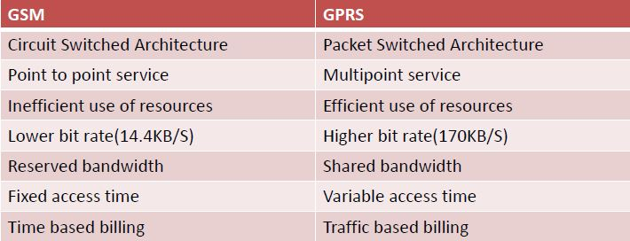
Difference Between GSM And GPRS

Slide 4
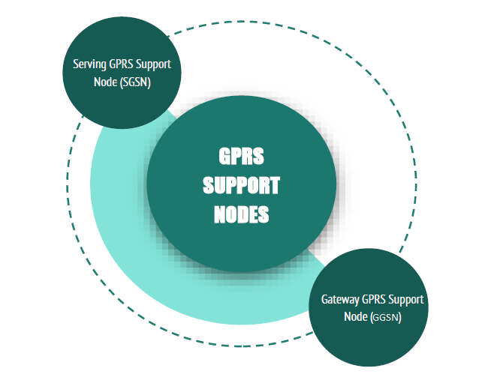
GPRS SUPPORT NODES
GPRS supports
Serving GPRS Support
Node(SGSN)
Gateway GPRS Support
Node (GGSN)

Slide 5
SGSN( Serving GPRS Support Node )
● Routing the packet switched data to and from the
mobile station.
● Mobility management.
● Data management.
● Authentication and charging for cells.
● Stores the location information of the user.

Slide 6
GGSN ( Gateway SPRS Support Node )
● Provides a gateway between GPRS and PDN (Packet
Data Networks).
● Converts data from SGSN to PDP format (Packet
Data Protocol).
● Stores the current SGSN address.
● Stores the location of user in it’s location register.
● Performs authentication and charging functions.

Slide 7
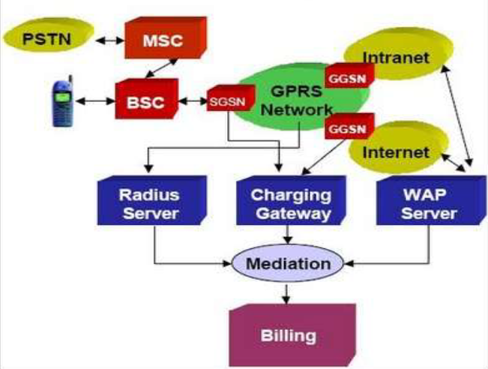
GPRS ARCHITECTURAL COMPONENTS

Slide 8
HOW GPRS WORK?
When a user turns on a GPRS device,
typically it will automatically scan for a local
GPRS channel.
If an appropriate channel is detected, the
device will attempt to attach to the network.
The SGSN receives the attach request,
fetches subscriber profile information from
the subscriber’s HLR node, and
authenticates the user.
Ciphering may be established at this point.

Slide 9
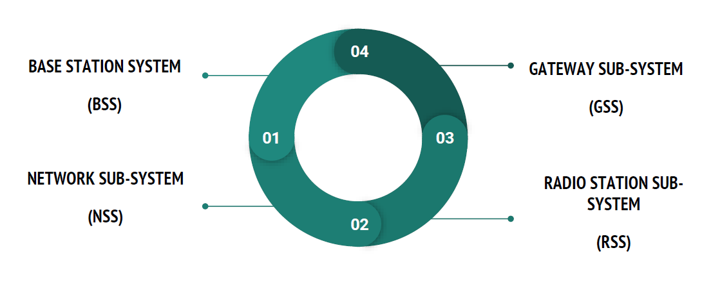
GPRS SUBSYSTEM

Slide 10
BASE STATION SYSTEM (BSS)
● BSS needs enhancement to
recognize and send packet data
● BSS includes BTS (Base
Transceiver Station) and MS
(Mobile Station)
NETWORK SUB-SYSTEM (NSS)
● It consists of a number of SGSN
(Serving GPRS Support Node)
● Also consists of a number of MSC
(Mobile-Service Switching Center)
● Helps in authentication, operation
and maintenance of subsystems
RADIO STATION SUB-SYSTEM (RSS)
● Consists of a number of MS
(Mobile Station), BTS (Base
Transceiver Station) and BSC (Base
Station Controller)
● Stores a CKSN (Cipher Key
Sequence Number - a logical
identity)
GATEWAY SUB-SYSTEM (GSS)
● Consists of SGSN (Serving GPRS
Support Node) and GGSN (Gateway
GPRS Support Node)
● Provides connections to other
networks and PDA (Public Data
Network)

Slide 11
APPLICATIONS
CHAT
INFORMATION SERVICES AS TEXT OR GRAPHICS
STILL IMAGES
MOVING IMAGES
WEB BROWSING
AUDIO REPORTS
DOCUMENT SHARING
JOB DISPATCH
CORPORATE MAIL
LAN APPLICATIONS
VEHICLE POSITIONING
FILE TRANSFER

Slide 12
CONCLUSION
● GPRS provides efficient access to Packet Data Networks
● Multislot operation in GPRS leads to efficient channel utilization
● GPRS is more effective for long data packet transmission than short ones.

