Slide 1


Subject Name :WIRELESS COMMUNICATION Presentation Title : Code Division Multiple Access
JEPPIAAR INSTITUTE OF TECHNOLOGY
“Self-Belief | Self Discipline | Self Respect”
Department of Electronics and communication Engineering
Team Members:
Students Name Reg . No:
1.HARITHA R 210617106038
2.HARI PRIYA H V 210617106037
3.ELAYAVATHI E 210617106031
4.BENIL RICHARDS R 210617106016
5.BARATH RAJ S 210617106018
6.DILSIAN 210617106024

Slide 2
Objective
To study about CDMA
To understand its working
To know the types of CDMA
To find its advantage & disadvantage
To know about its application.

Slide 3
INTRODUCTION TO CDMA
CDMA-CODE DIVISION MULTIPLE ACCESS
Its bandwidth is of 1.5 to 5 MHz
Refers to any of several protocols used in 2G &3G wireless communication.
Digital wireless data transmission system
Uses special random numbers to encode bits of information.

Slide 4
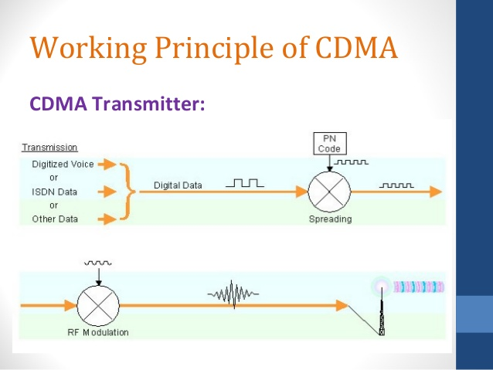

Slide 5
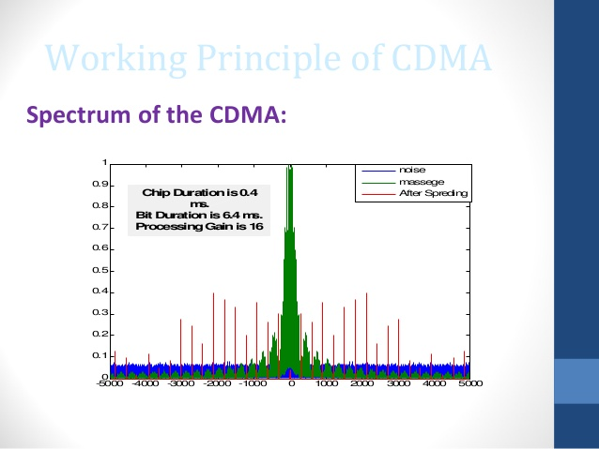

Slide 6
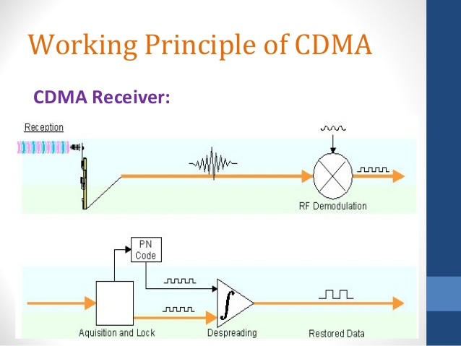

Slide 7
WORKING PRINCIPLE OF CDMA
CDMA TRANSMITTER:
The voice has to be digitalize(PCM)
Each user is given a unique PN code
The codes must have low cross correlation
The transmitter multiplies the code by the data to get the coded massage(bit)

Slide 8
WORKING PRINCIPLE OF CDMA
CDMA RECEIVER:
* The received signal is multiplied again by the same code that used in the transmitter.
Integrate over bit duration and then using a hard decision to get transmitted massage(bit).

Slide 9
APPLICATION OF CDMA
Mainly used in U.S.A
Standard was finished in 1993 and first commercially launched in 1996
data rate is 9.6 kbps
chip rate of 1.2288 mchip/s
allocated bandwidth is 1.25MHz

Slide 10
ADVANTAGES
CDMA consumes less power .
* It covers large areas .so cell size in CDMA’s is larger
* 3 to 5 times more than GSM
* It has well defined path to higher data rates.

Slide 11
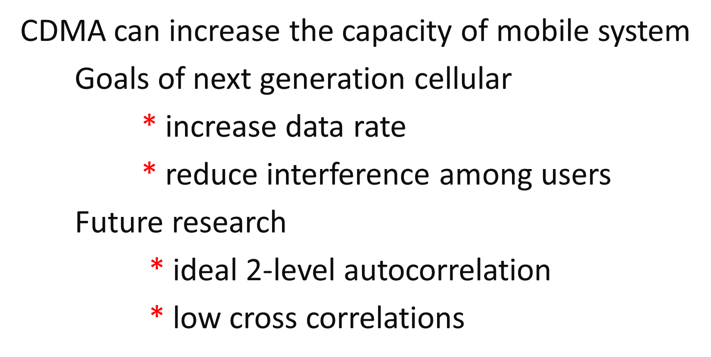
CONCLUSION

Slide 12
Reference
http://www.wirelesscommunication.nl/reference/ppt/cdma1.pdf
https://en.wikipedia.org/wiki/Code-division_multiple_access

