Slide 1


Subject Name : EC8652- COMMUNICATION THEORY Presentation Title: Distributions Of Random Variable
JEPPIAAR INSTITUTE OF TECHNOLOGY
“Self-Belief | Self Discipline | Self Respect”
Department of Electronics and Communication Engineering
Team Members:
Students Name Reg.No:
1..G.BHAVANA DEVI 210618106008
2.P.VAISHALI 210618106039
3.K.SHANJAI 210618106034
4.M.MANOJ 210618106024
5.R.SRIVATHASAN 210618106036
6.S.HARIGOVIND 210618106015

Slide 2
Objective
To analyse of distribution of random variable and its types features of random variable

Slide 3
DEFINITION
The Distribution of a Variable is a description of the relative numbers of times each possible outcome will occur in a number of trials.
There are two types of distribution.
Discrete.
Continuous.

Slide 4
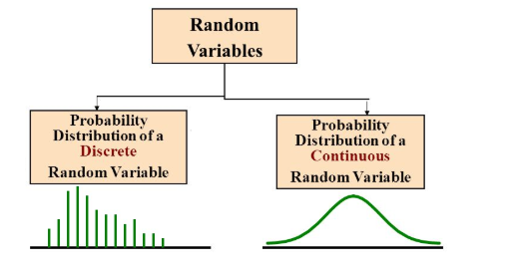
TYPES

Slide 5
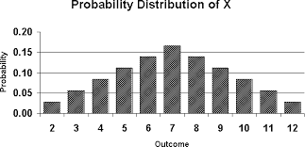
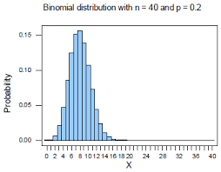
Block Diagram

Slide 6
Discrete
The probability Distribution. of a Discrete Random Variable x is a list of each possible value of x together with the probability that x takes that value in one trial of the experiment.
There are Three types:
Binomial.
Poison.
Geometric.

Slide 7
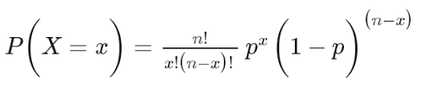
Binomial
A Binomial Random Variable is the number of successes x in n repeated trials of A Binomial Experiment.
The probability distribution of a Binomial Random Variable is called a Binomial Distribution.

Slide 8
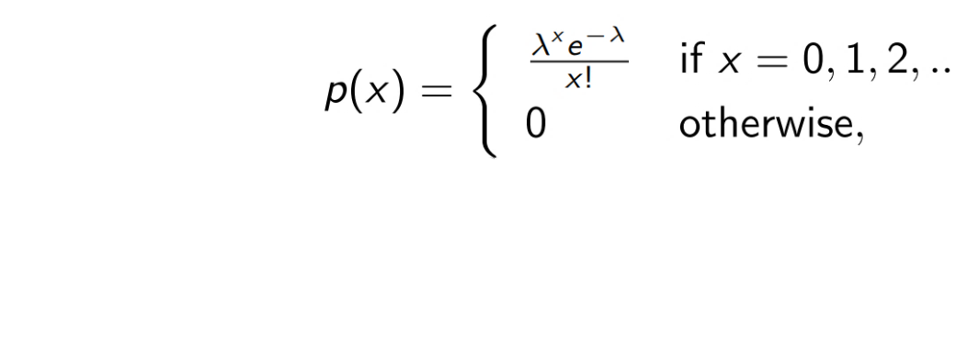
POISON
The Poisson Distribution is a discrete probability Distribution for the counts of events that occur randomly in a given interval of time (or space).
If we let x = the number of events in a given interval. then, if the mean number of events per interval is λ>0.

Slide 9
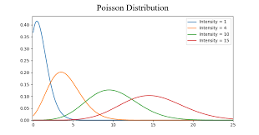
FLOW CHART

Slide 10
Geometric
The Geometric Distribution represents the number of failures before you get a success in a series of Bernoulli trials.
This discrete probability Distribution is represented by the probability density function:
f(x) = (1 − p)^{x} ⁻ ¹p.
where,
p is success and 1-p is failure.

Slide 11
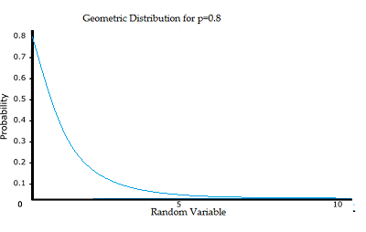

Slide 12
Continuous
If a Random Variable is a Continuous Variable, its probability Distribution is called Continuous probability Distribution.
A Continuous probability Distribution differs from a discrete probability Distribution in several ways. the probability that a Continuous Random Variable will assume a particular value is zero.

Slide 13
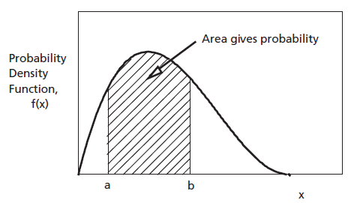

Slide 14
EXAMPLE OF RANDOM VARIBLE
Number of marbles in a jar
Number of students present
Number of heads when tossing two coins.

Slide 15
Reference
www.wikipedia.org
www.slideshsre.com

