Slide 1


Subject Name :WIRELESS NETWORK Presentation Title:EVOLUTION OF WIRELESS ROUTING PROTOCOLS
JEPPIAAR INSTITUTE OF TECHNOLOGY
“Self-Belief | Self Discipline | Self Respect”
Department of Electronics and communication Engineering
Team Members:
Students Name Reg.No:
1.Bala kumar.A 210617106015
2.Venkatesh.J 210617106083
3.Karthik.G 210617106046
4.Gopika.C.A 210617106033
5.Preetha.S 210617106062
6.Bharath kumar.S 210617106017

Slide 2
Objective
To Design/ Analyze/ Evaluate
An ad-hoc network is the cooperative engagement of a collection of mobile nodes without the required intervention of any centralized access point or existing infrastructure. We present Ad-hoc On Demand Distance Vector Routing (AODV), a novel algorithm for the operation of such ad-hoc networks. Each mobile host operates as a specialized router, and routes are obtained as needed (i.e., on-demand) with little or no reliance on periodic advertisements. Our new routing algorithm is quite suitable for a dynamic self starting network, as required by users wishing to utilize ad-hoc networks. AODV provides loop-free routes even while repairing broken links. Because the protocol does not require global periodic routing advertisements, the demand on the overall bandwidth available to the mobile nodes is substantially less than in those protocols that do necessitate such advertisements.

Slide 3
Technical Details
From the AD HOC ERA and the MESH ERA
New design goals
-high throughput vs. connectivity
New “EXOTIC” optimaization techniques
Cross-layer design

Slide 4
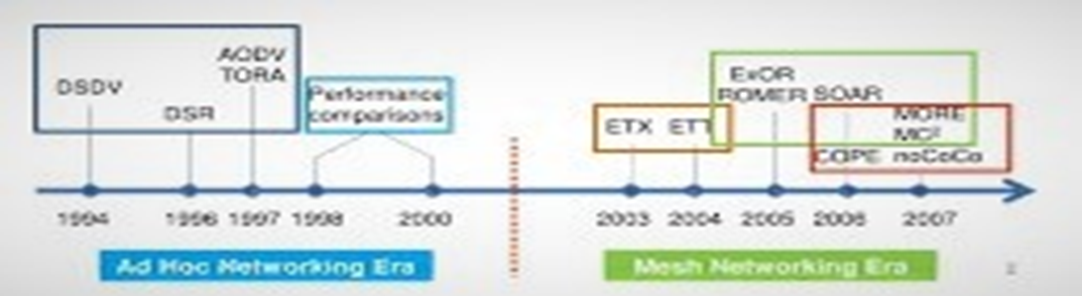
Block Diagram/ Work Flow/ Flow Chart

Slide 5
Technical Details
AD HOC NETWORKING ERA
Primary challenge
*deal with route breaks due to host mobility
Layering principles
*Routing protocols discovers route.
*802.11 unicast transmits packets to next hop
#ACK/RETX, exponential backoff
Evaluation
*PDR,control overhead,tradeoffs
*Low constant offered load

Slide 6
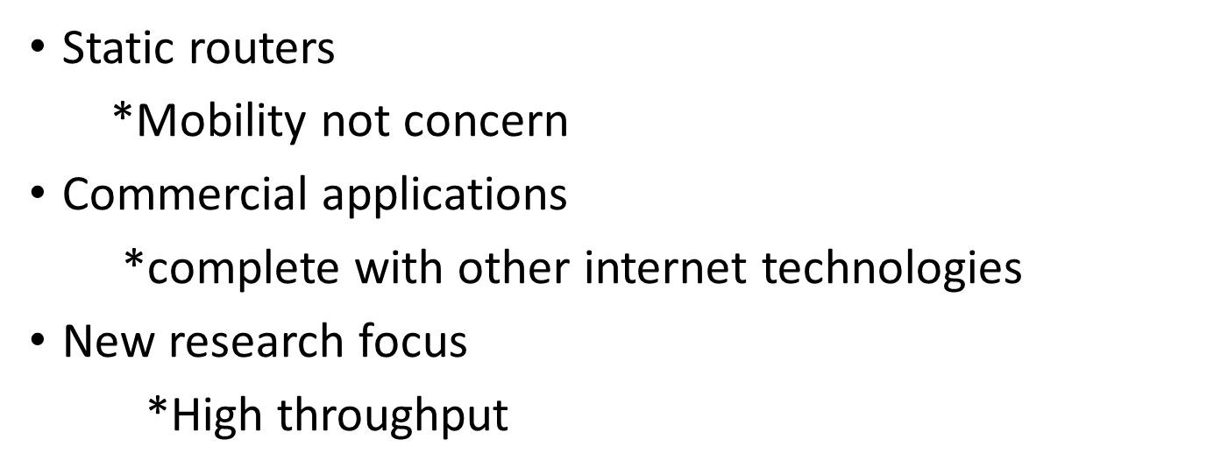
Technical Details
MESH NETWORKING ERA

Slide 7
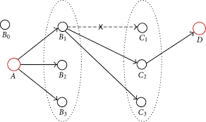
Technical Details
OPPOURTNISTIC ROUTING
First demonstrated in ExOR[SIGCOMM ‘05]
Packets broadcast at each hop,all neighbors can receive it
Neighbors closest to destination rebroadcasts
*Coordination required

Slide 8
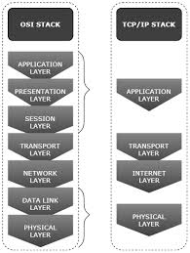
Technical Details
EVOLUTION OF PROTOCOL STACK

Slide 9
Technical Details
IMPLIMENTATIONS ON PROTOCOL EVALUATION
Evaluation becomes a much subtler task
*Possible conficts between new and old mechanisms
*Inter flow network coding vs. rate control
Current state
*Diverse set of evaluation methodologies
*Lack of clear guidelines

Slide 10
Result & Discussion
TYPES OF ROUTING PROTOCOL
Interior gateway protocols type 1
*Linkstate routing routing protocol
1.OSPF
2.IS-IS
Interior gateway protocols type 2
*Distance vector routing protocol
1.Routing information protocol
2.RIPv2
3.IGRP

Slide 11
Future Scope
ROUTING SOFTWARES
Bird internet routing daemon
Quagga
GNU Zebra
OpenBGPD
OpenOSPFD
XORP

Slide 12
Reference
Scholarly articles for evolution of wireless routing protocol reference
Routing protocols for ad hoc mobile wireless networks - ‎Misra - Cited by 159 … protocol based on evolutionary algorithms for wireless … - ‎Huruială - Cited by 34 … protocol based on evolutionary game theory in wireless … - ‎Lin - Cited by 27

