Slide 1


JEPPIAAR INSTITUTE OF TECHNOLOGY
“Self-Belief | Self Discipline | Self Respect”
Department of Electronics and communication Engineering
Subject Name :WIRELESS NETWORK
Presentation Title :Enhanced Data Rates for GSM Evolution
Team Members:
STUDENTS NAME | REG.NO
1.HARITHA R | 210617106038
2.HARI PRIYA H V | 210617106037
3.ELAYAVATHI E | 210617106031
4.BENIL RICHARDS R | 210617106016
5.BARATH RAJ S | 210617106018
6.DILSIAN | 210617106024

Slide 2
OBJECTIVE
To combine the two big technologies, GSM (Global System for Mobile Communication) and TDMA (Time Division Multiple Access).
To improve speed and eﬃciency of 2G.
To use the same spectrum of 2G for EDGE.
3/27/2020
JEPPIAAR INSTITUTE OF TECHNOLOGY
2

Slide 3
INTRODUCTION
•
EDGE:
It was standardized by 3GPP as a part of GSM family and was deployed in GSM networks in 2003.
EDGE is a high speed mobile data standard intended to enable 2G GSM (Global System for Mobile Communication) and TDMA (Time Division Multiple Access).
It built over the 2g technology.
Transmits data at the rate of 384 kbps.
Voice over IP was introduced later.

Slide 4
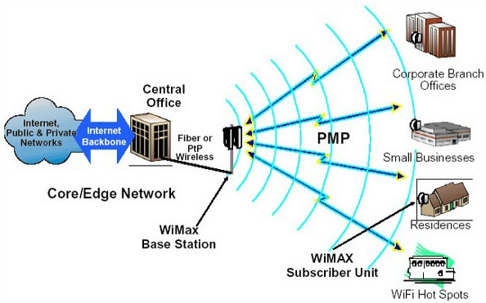
EDGE

Slide 6
Transmission technique in EDGE
In addition to Gaussian minimum-shiG
keying (GMSK), EDGE uses higher-order PSK/8 phase shiG keying (8PSK) for the upper ﬁve of its nine modulation and coding schemes.
EDGE can carry a bandwidth up to 236 kbit/s for 4 timeslots in packet mode.
It also enhances the circuit data mode
called HSCSD, increasing the data rate of this service.

Slide 7
EDGE modulation and coding scheme (MCS)
The channel encoding process in GPRS as well as EGPRS/EDGE consists of two steps:
First, a cyclic code is used to add parity bits, which are also referred to as the Block Check Sequence.
Followed by coding with a possibly punctured convolutional code.

Slide 8
Reduced Latency
In EDGE, a single RLC data block is transmitted over four frames, using a single time slot.
In addition, Reduced Latency also implies support of Piggy-backed ACK/NACK (PAN), in which a bitmap of blocks not received is included in normal data blocks.
With EDGE, the RLC interface could operate in either acknowledged mode, or unacknowledged mode.

Slide 9
ADVANTAGES
Short-term beneﬁts: Capacity and performance
Easy implementation on a GSM/GPRS network
Cost eﬀective
Increases the capacity and triples the data rate of GPRS
Enables new multimedia services
Long-term beneﬁt: Harmonization with WCDMA

Slide 10
APPLICATION
It is used in transmission of data and voice
Internet
Online transactions
Long range communication systems
Streaming applications
Very high speed downloads
Corporate intranet connections
Quicker MMS
Video phone

Slide 11
CONCLUTION
EDGE paves the way into mobile multimedia applications whilst oﬀering the maximum of investment protection.
No need for new network elements.
Low risk of investment because of the dual slot of GSM/EDGE
Can use the same spectrum that of the GSM

Slide 12
REFERENCE
https://en.wikipedia.org/wiki/ Enhanced_Data_Rates_for_GSM_Evolution
https://www.tutorialspoint.com/enhanced- data-rates-for-gsm-evolution-edge

