Slide 1

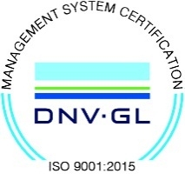
Subject Name : EC8491 – Communication Theory Presentation Title: FDM and its Applications
JEPPIAAR INSTITUTE OF TECHNOLOGY
“Self-Belief | Self Discipline | Self Respect”
Department of Electronics and Communication Engineering
Team Members:
Students Name Reg.No:
1. ABILASH N 210618106001
2. ABINESH A 210618106002
3. AKASH M 210618106003
4. MOHAMMAD FARHAN S 210618106025
5. B.R KAVIPRIYA 210618106018
6. D.KAVIPRIYA 210618106019

Slide 2
Objective
To analyze
The Real Time Application of FDM(frequency division multiplexing)
Its Advantages and Disadvantages and Future scope.

Slide 3
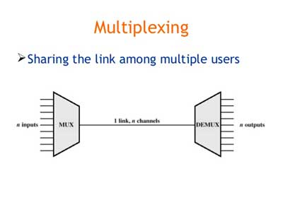
Introduction
Frequency Division Multiplexing (FDM) is a networking technique in which multiple data signals are combined for simultaneous transmission via a shared communication medium.
Frequency Division Multiplexing (FDM) is a networking technique in which multiple data signals are combined for simultaneous transmission via a shared communication medium.
Frequency Division Multiplexing (FDM) is a networking technique in which multiple data signals are combined for simultaneous transmission via a shared communication medium.

Slide 4
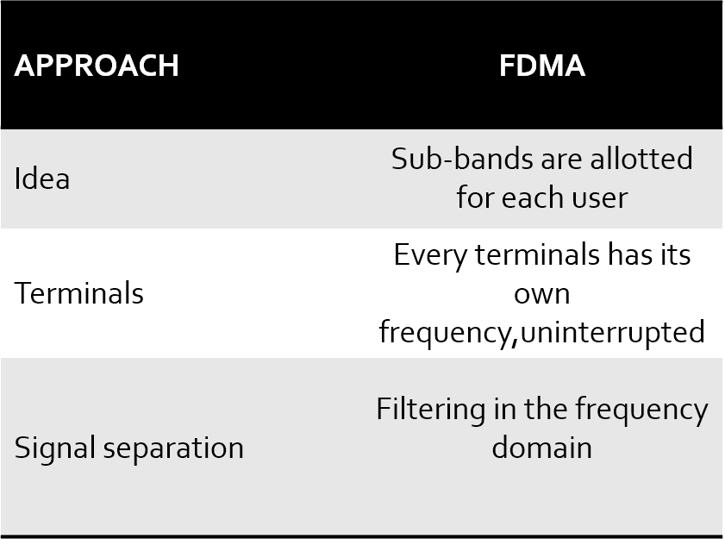
Different channels are assign with different frequency bands
Guard bands
Nonlinear effects in FDMA

Slide 5
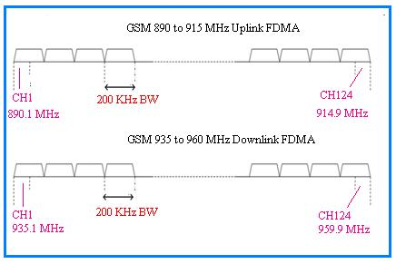
Up link and down link of FDMA

Slide 6
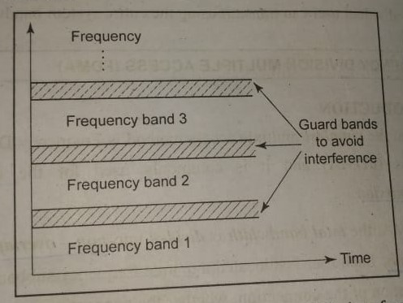
GURAD BANDS
A guard band is a narrow frequency range that separates two ranges of wider frequency. This ensures that simultaneously used communication channels do not experience interference, which would result in decreased quality for both transmissions. Guard bands are used in frequency division multiplexing (FDM)

Slide 7
Nonlinear effects in FDMA
In FDMA system many channels share the same antenna at the base station.
The power amplifiers or the power combiners, when operated at or near saturation for maximum power efficiency are non-linear.
Nonlinearities cause signal spreading in the frequency domain and generate intermodulation frequencies.
To minimize the effects of intermodulation distortion, stringent RF filters are required to reject intermodulation distortion.RF filters are heavy,and costly.

Slide 8
Main features
In FDMA, every user shares the frequency channel or satellite transponder simultaneously; however, every user transmits at single frequency.
In FDMA, every user shares the frequency channel or satellite transponder simultaneously; however, every user transmits at single frequency.
FDMA demands highly efficient filters in the radio hardware, contrary to CDMA and TDMA.
FDMA is devoid of timing issues that exist in TDMA.
All users transmit and receive at different frequencies because every user receives an individual frequency slot.

Slide 9
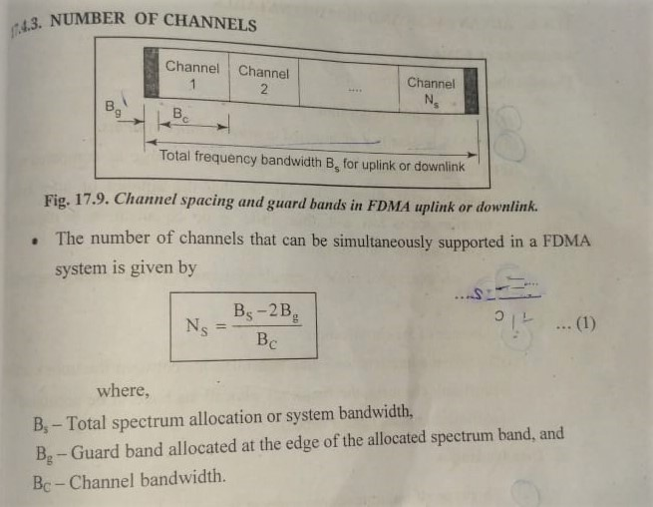
Main features

Slide 10
ADVANTAGES
➨It allocates dedicated frequencies to different stations. Moreover there are separate bands for both uplink and downlink. Hence stations transmit and receive continuously at their allocated frequencies.
➨It is very simple to implement with respect to hardware resources.
➨FDMA is efficient when constant traffic is required to be managed with less number of user population.

Slide 11
DISADVANTAGES
➨In FDMA, frequencies are allocated permanently and hence spectrum will be wasted when stations are not transmitting or receiving. ➨Network and spectrum planning is cumbersome and time consuming. ➨It uses guard bands to prevent interference. This wastes very useful and scarce frequency resources. ➨It requires RF filters to meet stringent adjacent channel rejection specifications. This increases cost of the system. ➨Maximum bit rate per channel is constant and hence can not be used for varying data rate requirements as per QoS and priorities.

Slide 12
Future Scope
FDM is also used in 4G and 5G technologies.
FDM is commonly used in TV networks.
FDM is used for FM and AM broadcasting.
First generation cellular telephone also uses FDM.

Slide 13
Reference
“Communication Engineering” suchitra publication (Dr.k.Muralibabu,Dr.L.Agilandeeshwari)
Wikipedia.com

