Slide 1


JEPPIAAR INSTITUTE OF TECHNOLOGY
“Self-Belief | Self Discipline | Self Respect”
Department of Electronics and Communication Engineering
Subject Name: Wireless Networks
Presentation Title: GPRS Architecture
Team Members:
Student Name Reg. No
    M Divya 210617106026
    S Divya 210617106028
    Divyashree 210617106029
    P Dominic 210617106030
    S Balaji 210617106013
    Anbin D Meshach 210617106009

Slide 2
What is GPRS?
>Bearer service for GSM
>Packet-switched
>Can inter-operate with other packet-switched networks(eg;IP,X.25)
>Higher data-rates and lower connection times than conventional GSM

Slide 3
GPRS Integration-1
Addition of GPRS support nodes(GSN)
All GSNs connected by IP-based GPRS backbone network
-Intra PLMN(Public Land Mobile Network):Connect GSNs on same network, private IP-based networks of the provider
-Inter PLMN: Connect GSNs on different PLMNs; requires a roaming agreement to be installed

Slide 4
GPRS Integration-2
SERVING GSN:
> Authentication/charging
>Visited location registry(VLR)
>User profiles
#GATEWAY GSN:
>Packet delivery between mobile stations and external packet data networks(PDN) eg;IP,X.25
>Authentication/charging

Slide 5
GSM Network Interface-1
Gb Interface:Connects the BSC with the SGSN
Gn/Gp interfaces: Transmits user data and signalling data between GSNs
> Gn for transmission on same PLMN
> Gp for transmission on external PLMNs
Gf interface: IMEI queries
Gi interface: Connect to external PDNs

Slide 6
GSM Network Interface-2
Gr Interface: Exchange of usefr information between HLR and SGSN
Gc Interface: Exchange of location information between GGSN and HLR
Gs Interface: Connects database of SGSN and MSC/VLR to coordinate between GPRS and conventional GSM networks
Gd Interface: Connects SGSN with SMS Gateway MSC (SMS-GMSC)

Slide 7
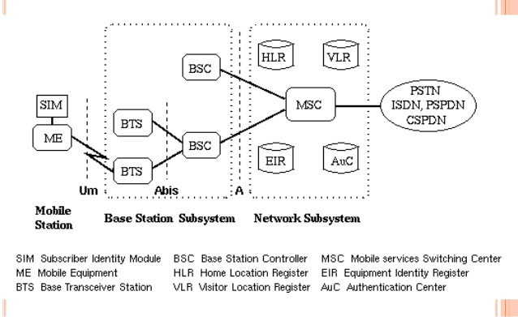
GSM System Architecture

Slide 8
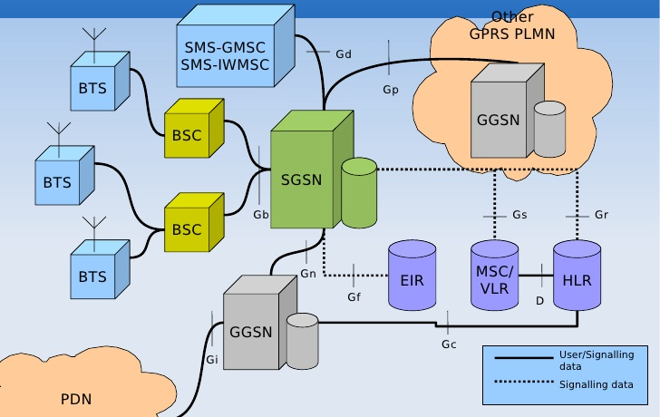
GPRS System Architecture

Slide 9
Services
Bearer services for GPRS offer end-to-end packet-switched data transfer
Two types:
*Point to point (PTP)
-Internet access
-SMS messages
*Point to multipoint (PTM)
-Unidirectional distribution of information (eg;weather,news)
-Conferencing services between multiole users

Slide 10
Quality of Service
QOS profiles can be defined using parameters derived from service precedence, reliability, delay and throughput
QOS profiles can be negotiated between the mobile user and the network, per session, depending on current resources, and can affect billing
Three priorities: High, Medium, Low
Three reliability classes that guarantee maximum values of loss, duplicaion, mis sequencing and corruption of packets
Delay defines maximum mean delay and 95-percentile delay
Throughput specifies peak ad mean bit-rate

Slide 11
GPRS and Conventional GSM
GSM/GPRS services can be used in parallel
Three classes of mobile station
>Class A-Simultaneous use of GSM and GPRS
>Class B-Can register for both GSM and GPRS but only use one at a time
>Class C-Can attach for only either GSM or GRPS(with the exception of SMS messages)

Slide 12
References
ETSI
^ 3GPP
^ "General packet radio service from Qkport". Archived from the original on 2010-01-28. Retrieved 2009-12-14.
^ Mobile Phone Generations from Archived June 11, 2010, at the Wayback Machine
^ Jump up to:ª ^{b} ^{c} ^{d} ^{e} ^{f} 3rd Generation Partnership Project (November 2014). "3GGP TS45.001: Technical Specification Group GSM/EDGE Radio Access Network; Physical layer on the radio path; General description". 12.1.0. Retrieved 2015-12-05.
^ 3rd Generation Partnership Project (June 2015). "3GGP TS45.001: Technical Specification Group GSM/EDGE Radio Access Network; Mobile Station (MS) - Base Station System (BSS) interface; Radio Link Control / Medium Access Control (RLC/MAC) protocol; section 10.0a.1 - GPRS RLC/MAC block for data transfer". 12.5.0. Retrieved 2015-12-05.
^ 3rd Generation Partnership Project (June 2015). "3GGP TS45.001: Technical Specification Group GSM/EDGE Radio Access Network; Mobile Station (MS) - Base Station System (BSS) interface; Radio Link Control / Medium Access Control (RLC/MAC) protocol; section 10.2.1 - Downlink RLC data block". 12.5.0. Retrieved 2015-12-05.
^ 3rd Generation Partnership Project (March 2015). "3GGP TS45.002: Technical Specification Group GSM/EDGE Radio Access Network; Multiplexing and multiple access on the radio path (Release 12)". 12.4.0. Retrieved 2015-12-05.
^ "GPRS and EDGE Multislot Classes". Archived from the original on 2010-11-27. Retrieved 2010-06-21.
^ Bernhard Walke, Wolf Mende, Georgios Hatziliadis: “CELLPAC: A packet radio protocol applied to the cellular GSM mobile radio network”, Proceedings of 41st IEEE Vehicular Technology Conference, May 1991, 408-413.
^ Peter Decker, Bernhard Walke: “A General Packet Radio Service proposed for GSM”, ETSI SMG Workshop “GSM in a Future Competitive Environment”, Helsinki, Finland, Oct. 13, 1993, pp. 1-20.
^ Program “Publish or Perish”, see [1] returns to a search for P. Decker, B. Walke their most cited paper that (after double click) unveils US patents referencing that paper

