Slide 1


JEPPIAAR INSTITUTE OF TECHNOLOGY
“Self-Belief | Self Discipline | Self Respect”
Department of Electronics and Communication Engineering
Subject Name: wireless network
Presentation Title: GSM TECHNOLOGIES-ARCHITECTURE
Team Members:
Students Name Reg.No:
1.AKASH.B 210617106005
2.AKASH.U 210617106006
3. AMARAN.E 210617106008
4. VIJAYANAND.R 210617106089
5. AISHWARYA.V 210617106002
6. BHAVANISHRUTHI.S 210617106019
7.DINU.J 210617106025

Slide 2
OBJECTIVES
The Overview of GSM Architecture has a brief explanation of the different networks subsystems and description of the functionality of the elements within each of the subsystems.
The evaluation and generation of GSM explained
The general architecture like Mobile Station, Base Station and The Networking system are explained

Slide 3
GSM
Global System For Mobile(GSM) is a second generation cellular standard developed to cater voice services and data delivery using digital modulation GSM digitizes and compresses data,then sends it don a channel with two other streams of user data ,each in its own time slot.It operates at either the 900 megahertz(MHZ)or 1800 MHZ frequency band

Slide 4
GSM HISTORY
Developed by group speciale mobile(founded 1892) which was an initiative of CPET(Conference of European Post and Telecommunication)
Under ETSI,GSM is named as ”Global System for Mobile Communication” in 1989
Full set of specifications phase-I became available in 1990
Phase 2 of the GSM specifications occurs in 1995.Coverage is extended to rural areas

Slide 5
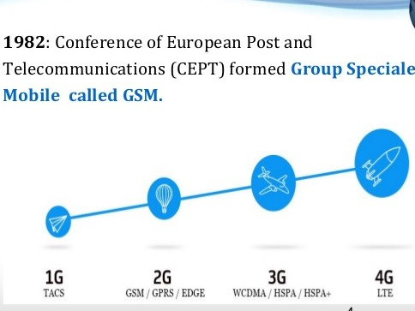
The Evolution Of GSM
1G -Voice Signals only
-Analogue cellular phones
-NMT,AMPS
2G -Voice and data signals
-Digital Fidelity Cellular phones
-GSM,CDMA,TDMA
3G -Voice,Data and videos signals
-Video Telephony/Internet Surfing
-3G,W-CDMA,UMTS
4G -Enhanced 3G/Interoperability Protocal
-High speed and IP-based
-4G,mobile IP

Slide 6
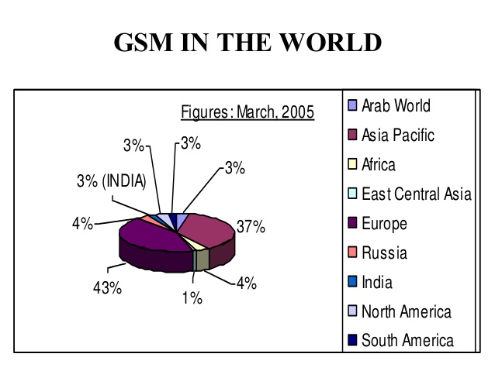
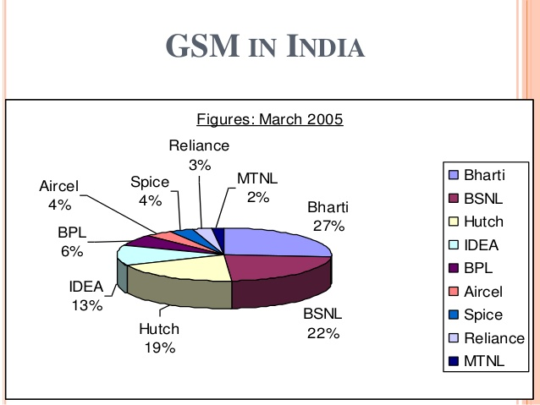

Slide 7
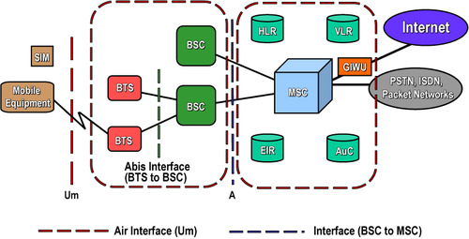
GSM ARCHITECTURE

Slide 8
GSM ARCHITECTURE AND ITS TYPES
Mobile Station(MS)
Mobile equipment(ME)
Subscriber Identity Module(SIM)
Base Station Subsystem(BSS)
Base Transceiver Station(BTS)
Base station controller(BSC)
Networking Switching Subsystem(NSS)
Mobile Switching Center(MSC)
Home Location Register(HLR)
Visiter Location Register(VLR)
Authentication Center(AUC)
Equipment Identity Register(EIR)

Slide 9
MOBILE STATION(MS)
Mobile stations (MS), mobile equipment (ME) or as they are most widely known, cell or mobile phones are the section of a GSM mobile communications network that the user sees and operates.
There are a number of elements to the cell phone,Although the two main elements are the main hardware and the SIM
Main Hardware
The hardware itself contains the main elements of the mobile phone including the display, case, battery, and the electronics used to generate the signal, and process the data receiver and to be transmitted.
Subscriber Identity Module(SIM)
Smart card contains IMSI
Allows user to send and receive calls.
Protected by a password or pin
Can be moved from phone to phone

Slide 10
Base Station Subsystem(BSS)
The Base Station Subsystem (BSS) section of the 2G GSM network architecture that is fundamentally associated with communicating with the mobiles on the network.
It consists of two elements:
Base Transceiver Station (BTS):
The BTS used in a GSM network comprises the radio transmitter receivers, and their associated antennas that transmit and receive to directly communicate with the mobiles.
The BTS communicates with the mobiles and the interface between the two is known as the Um interface with its associated protocols.
Base Station Controller (BSC):
The BSC forms the next stage back into the GSM network. It controls a group of BTSs, and is often co-located with one of the BTSs in its group.
It manages the radio resources and controls items such as handover within the group of BTSs, allocates channels and the like.
It communicates with the BTSs over what is termed the Abis interface.

Slide 11
Networking Switching Subsystem(NSS)
The GSM system architecture contains a variety of different elements, and is often termed the core network. It is essentially a data network with a various entities that provide the main control and interfacing for the whole mobile network. The major elements within the core network include:
Home Location Registers(HLR)
Permanent database about mobile subscribers in a large services ares (generally one per GSM network operator)
Database contains IMSI,MSISDN,prepaid/postpaid,Rsoaming restrictions,Supplementray services
Visitor Locations Registers(VLR)
Temporary database which updates whenever new MS enters its area by HLR database
Controls those mobiles roaming in its area and it also reduces the number of quries to HLR
Database contains IMSI,TMSI,MSISDN,MSRN,Locations Area,Authentication key

Slide 12
Authentication Centre(AUC)
The AuC is a protected database that contains the secret key also contained in the user's SIM card. It is used for authentication and for ciphering on the radio channel.
SMS Gateway(SMS-G)
The SMS-G or SMS gateway is the term that is used to collectively describe the two Short Message Services Gateways defined in the GSM standards.
The two gateways handle messages directed in different directions. The SMS-GMSC (Short Message Service Gateway Mobile Switching Centre) is for short messages being sent to an ME.
The SMS-IWMSC (Short Message Service Inter-Working Mobile Switching Centre) is used for short messages originated with a mobile on that network.

Slide 13
Advantages Of GSM
Communication
-Mobile,Wireless communication support for voice and data services
Total mobility
-International access,Chip-card enables use os access point of different providers
Worldwide connectivity
-One number the network handles every location
High capacity
-better frequency efficiency,Smaller cells,More customer per cells.
High transmission quality
-High audio quality and reliability for wireless,Uninterrupted phone calls at higher speeds(e.g.,from cars,trains)

Slide 14
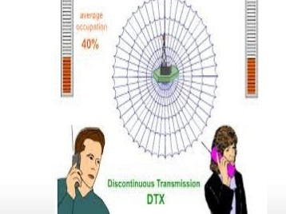
Disadvantages of GSM
Dropped and missed calls
Less efficiency
Security Issues

Slide 15
Applications of GSM
Mobile telephony
GSM-R
Telemetry System
-Fleet management
-Automatic meter reading
-Toll collection
-Remote control and fault reporting of DG sets
Value Added Services

Slide 16
Result and Discussion
The mobile telephony industry growing and that has become backbone for business success and efficiency and a part of modem lifestyles all over the world
In this session I have tried to give and over view of the GSM system. I hope that I gave the general flavor of GSM and the philosophy behind its design
Cellular mobile radio-the high end sophisticated technology that enables every one to communicate anywhere with anybody.
The GSM is standard that insures interoperability without stifling competition and innovation among the suppliers to the benefits of thr public both in terms of cost and services quality
The features and benefits expected in the GSM systems are superior speech quality,Low terminal,Operational and service costs,High level security,providing international roaming support of low power hand portable terminals and variety of new services and network facilities

Slide 17
References
[1] G. Gu, G. Peng, “The survey of GSM wireless communication system”, Computer and Information Application (ICCIA), 2010 International Conference on, Year: 2010, Pages: 121-124, DOI: 10.1109/ICCIA.2010.6141552
[2] M. Rahnema, “Overview of the GSM system and protocol architecture”, IEEE Communications Magazine, Year: 1993, Volume: 31, Issue: 4, Pages: 92- 100, DOI: 10.1109/35.210402
[3] P.L. Reilly, “GSM network architecture issues for the next century”, Vehicular Technology Conference, 1994 IEEE 44th , Year: 1994, Pages: 325-329 vol.1, DOI: 10:1109/VETEC.1994.345111
[4] B. Mallinder, "An overview of the GSM system, "Proc. Nordic Seminar on Digital Band Mobile Radio Commun”., pp.12-15, Sept. 1988
[5] Jay Jayapalan and Mike Burke,” Cellular Data services architecture and signaling”,” IEEE personal communication, second quarter”, pp.44-55, 1994.
[6] Khalid Al-Tawil, Ali Akarami, Habib Youssef.” A New Authentication Protocol for GSM Networks”. In IEEE 23rd Annual Conference on Local Computer Networks(LCN’98) (pp.21-30).
[7] Michel Mouly & Marie-Bernadette Paulet, The GSM System for Mobile System

Slide 18
THANK YOU

