Slide 1


Subject Name : Microprocessor And Microcontroller Presentation Title: INTERFACING OF DC MOTOR WITH 8051
JEPPIAAR INSTITUTE OF TECHNOLOGY
“Self-Belief | Self Discipline | Self Respect”
Department of Computer Science and Engineering
Team Members:
Students Name Reg.No:
1. Karunya A 210617106047
2. Divya R 210617106027
3. Adithyan S 210617106001
4. Thennarasu P 210617106079
5. Siva A 210617106075
6. Raj O 210617106065

Slide 2
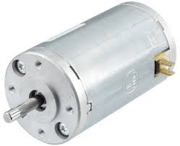
Objective
To Design/ Analyze/ Evaluate
DC MOTOR
ELECTRICAL MOTOR:
It is a machine which converts electrical energy -> mechanical energy.
Types:
Ac motor – Which runs on AC current
Dc motor – Which runs on DC current

Slide 3
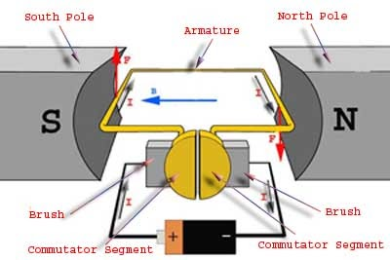
Working:
It uses electricity and magnetic field which
Produces torque in turn the rotor starts rotating.
Principle: Electromagnetism
When a current-carrying conductor is
placed in an external magnetic field it
will experience a force called Lorentz force.

Slide 4
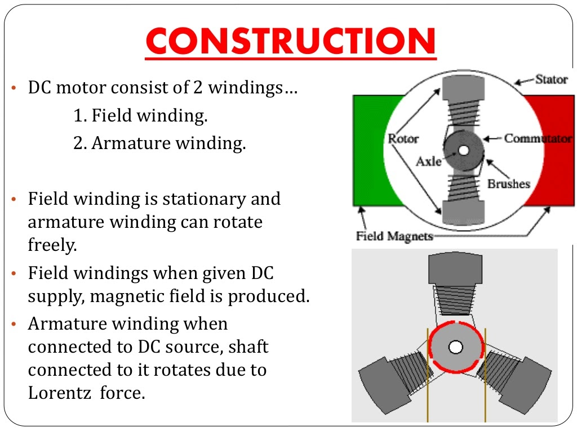

Slide 5
MICROPROCESSOR | MICROCONTROLLER
Microprocessor is used for GENERAL purposes. To use microprocessor other components such as Memory Components for receiving and sending data must be added to it. | Microcontrollers is designed for SPECIAL or SPECIFIC purpose. No other external components are needed for its application because all peripherals are built into it.(INBUILT)

Slide 6
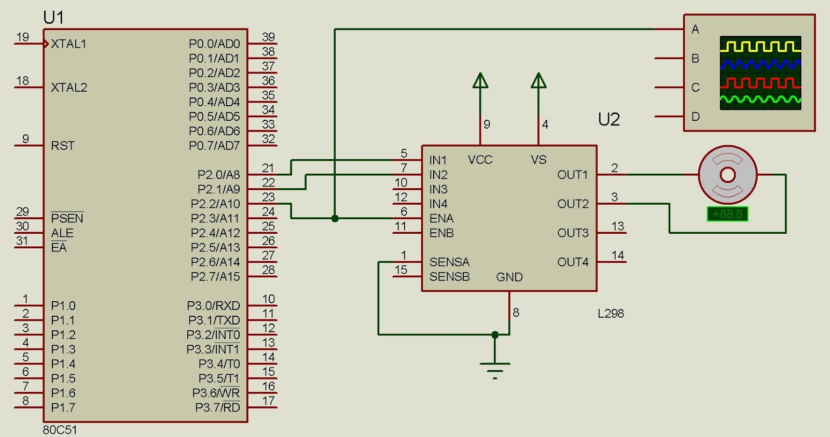
Technical Details
Interfacing 8051 with DC motor

Slide 7
Interfacing 8051 with DC motor
The direct current (DC) motor is a device that used in many industries in order to convert electrical energy into mechanical energy.
It plays a significant role in modern industry.
The maximum current that can be sourced from a 8051 microcontroller-15mA at 5v. But a DC Motor need currents very much more than that and it need voltages 6v, 12v, 24v etc..
Due to these reasons we can’t connect a DC Motor directly to a microcontroller.

Slide 8
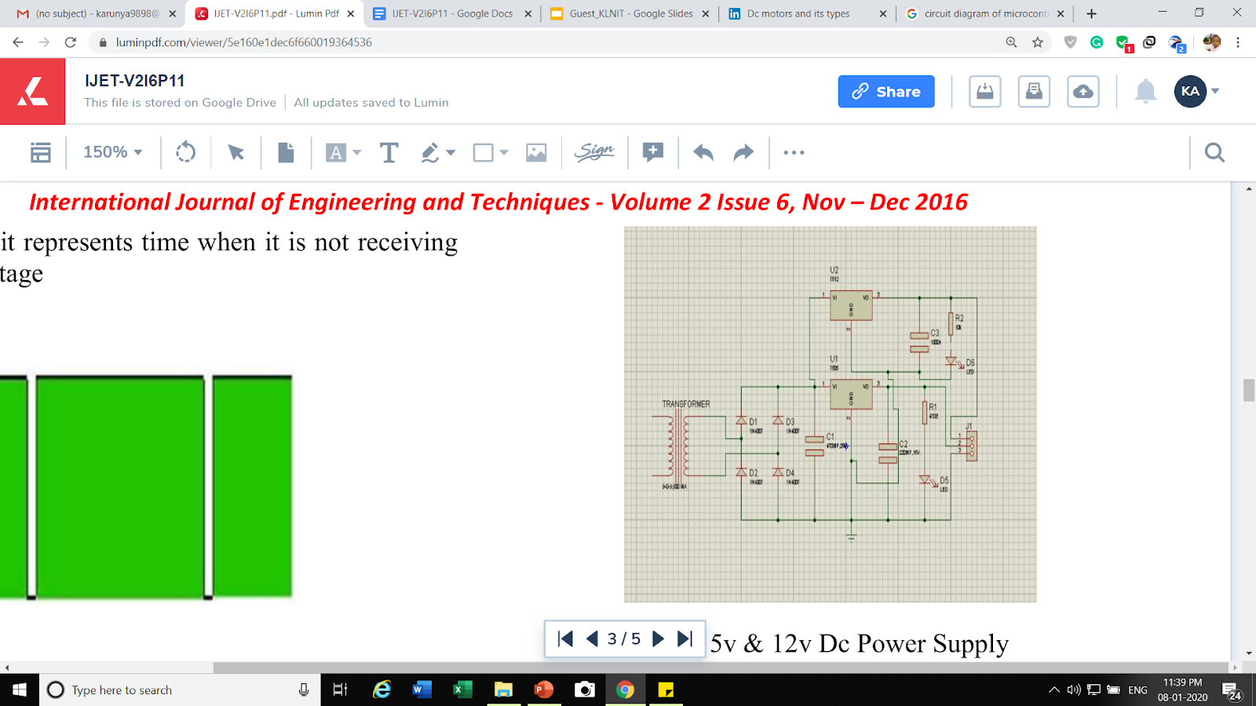
Technical Details
5v & 12v Dc Power Supply

Slide 9
THE CIRCUIT OF THE DC MOTOR SPEED CONTROLLER:
-> 230V, AC mains is stepped down by transformer to deliver secondary output of 12V, 500mA.
-> The secondary output is rectified by a full-wave bridge rectifier comprising diodes D1 through D4, filtered by capacitor C1.
-> Capacitor C2 bypasses any ripple present in the regulated output.
-> LED1 acts as the power-„on‟ indicator.

Slide 10
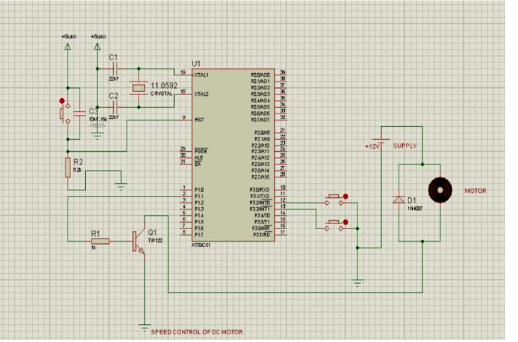
Result & Discussion
Circuit diagram of microcontroller based DC motor speed controller

Slide 11
WORKING OF IC AT89C51 (IC2): SPEED CONTROLLER SYSTEM
Consumes low- power,high-performance,8-bit microcontroller.
It creates pulses of varying width for Pulse width modulation and controls the motor speed.
To change the speed of the motor, switches S2 & S3 are pressed, an interrupt is generated, which changes the duty cycle of the pulse train.
Switch S2 interfaced to Interrupt-0
-> increases the duty cycle of the pulse waveform
Switch S3 interfaced to Interrupt-1
-> decreases the duty cycle of the pulse waveform

Slide 12
Port pin P1.1 is internally pulled cup which is used as the output to control the motor with driver transistor T1.
Whenever timer-0 overflows, the status of pin P1.1 is complemented and hence a duty cycle is generated.
This pin is interfaced to power transistor TIP122 (T1), which is used to drive the motor.
When the transistor is driven into saturation, current flows through the motor.
When the transistor is cut off, the motor current keeps flowing because of the motor’s inductance.
Diode D6 connected across the motor coil prevents reverse current flow.

Slide 13
Finally the software is written in C language.
Compiled using Keil C compiler, which generates Intel hex code for the microcontroller.
The generated hex code is burnt into the microcontroller.
Control Signals and Motor Status
P2.0/IN1 | P2.1/IN2 | Motor Status
LOW | LOW | Stops
LOW | HIGH | Clockwise
HIGH | LOW | Anti-Clockwise
HIGH | HIGH | Stops

