Slide 1

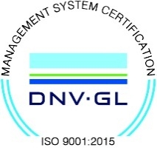
Subject Name :Transmission lines and RF systems Presentation Title: Types of insulators in transmission line
JEPPIAAR INSTITUTE OF TECHNOLOGY
“Self-Belief | Self Discipline | Self Respect”
Department of Electronics and communication Engineering
Team Members:
Students Name Reg.No:
1.Balakumar.A 210617106015
2.Bharath kumar.S 210617106017
3.Venkatesh.J 210617106083
4.Karthik.G 210617106046
5.Gopika.C.A 210617106033
6.Preetha.S 210617106062

Slide 2
Objective
To discuss about the types of insulators in transmission line.

Slide 3
WHAT IS INSULATORs
The overhead lines conductors should be support on the poles or tower in such way that current from conductors do not flow to earth through support.

Slide 4
Properties of insulators:
High mechanical strength in order to withstand conductor load , wind load.
High electrical resistance of insulator material in order to avoid leakage current to earth.
High relative permittivity of insulator material in order that di-electric strength is high.
High ratio of puncture strength to flashover.

Slide 5
There are several types of insulators but the most commonly used are :
Pin Insulator
Suspension Insulator
Strain Insulator and
Shackle insulator.

Slide 6
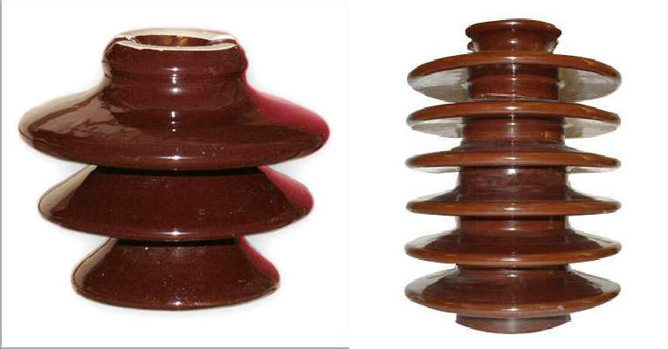
PIN INSULATORs

Slide 7
PIN INSULATOR
A pin insulator consists of a nonconducting material such as porcelain, glass, plastic, polymer, or wood.
As the name suggests, the pin type insulator is secured to the cross-arm on the pole.
There is a groove on the upper end of the insulator for housing the conductor.
The conductor passes through this groove and is bound by the annealed wire of the same material as the conductor.
Pin type insulators are used for transmission and distribution
of electric power at voltages upto 33 kV.

Slide 8

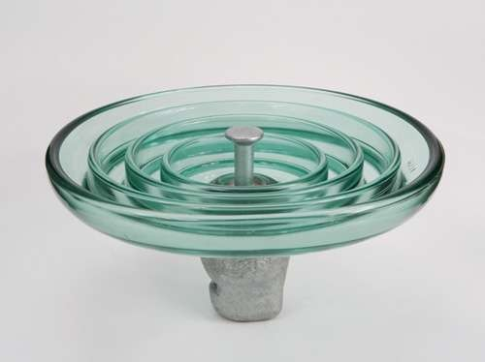
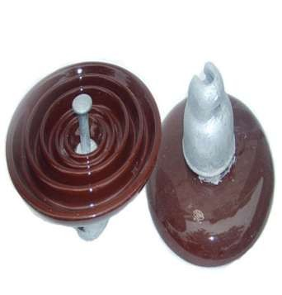
Fig.) Glass suspension insulator

Slide 9
SUSPENSION INSULATOR
For high voltages (>33 kV), it is a usual practice to use suspension type insulators consist of a number of porcelain discs connected in series by metal links in the form of a string.
The conductor is suspended at the bottom end of this string while the other end of the string is secured to the cross-arm of the tower.
Each unit or disc is designed for low voltage, say 11 kV.
The number of discs in series would obviously depend
upon the working voltage.

Slide 10

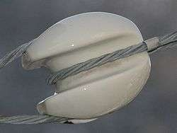
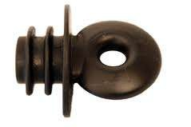

Slide 11
STRAIN INSULATOR
When there is a dead end of the line or there is corner or sharp curve, the line is subjected to greater tension.
In order to relieve the line of excessive tension, strain
insulators are used.
For low voltage lines (< 11 kV), shackle insulators are used as strain insulators.
However, for high voltage transmission lines, strain insulator consists of an assembly of suspension insulators as shown in Figure.

Slide 12

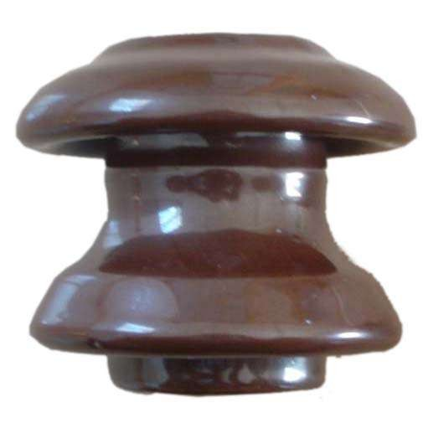

Slide 13
SHACKLE INSULATOR
In early days, the shackle insulators were used as strain insulators.
But now a days, they are frequently used for low
voltage distribution lines.
Such insulators can be used either in a horizontal position or in a vertical position.
They can be directly fixed to the pole with a bolt
or to the cross arm.

Slide 14
Causes of insulator failure
Cracking of insulator:
The porcelain insulator mainly consists of three different materials .The main porcelain body , steel fitting arrangement and cement to fix the part with porcelain . Due to changing climate conditions , these different materials in the insulator expand and contact in different rate .These unequal expansion and contraction of porcelain , steel and cement are the chief cause of cracking of insulator.
Defective insulation material
If the insulation material used for insulator is defective anywhere ,the insulator may have a high chance of being puncher from that place.

Slide 15
Flash over across insulator
If flash over occurs , the insulator may be over heated which may ultimately results into shuttering of
it.
Mechanical stresses on insulators
If an insulator has any weak portion due to manufacturing defect ,it may break from that weak portion when mechanical stress is applied on it by its conductor . these are the main causes of insulator failure.

Slide 16
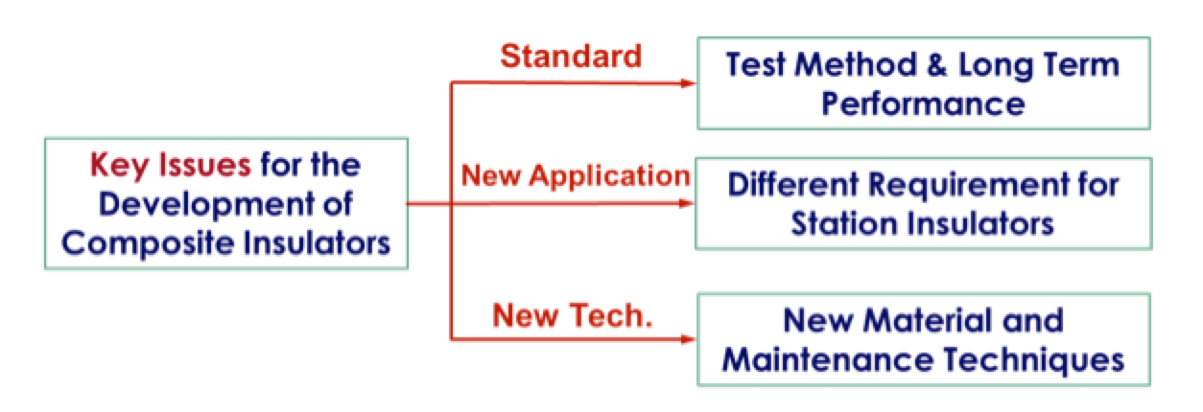
Future Scope

Slide 17
Reference
1.Wikipedia
2.www.eeeguide.com
3.www.electrical4u.com

