Slide 1


JEPPIAAR INSTITUTE OF TECHNOLOGY self belief | self discipline | self respect Department Of Electronics And Communication Engineering Subject name : Microprocessors and Microcontrollers Title : Microcontroller based Home Automation system
Team Members
Students Name Reg.No Gowri R 210617106034 Sathya A D 210617106072 Gowri pooja S 210617106035

Slide 2
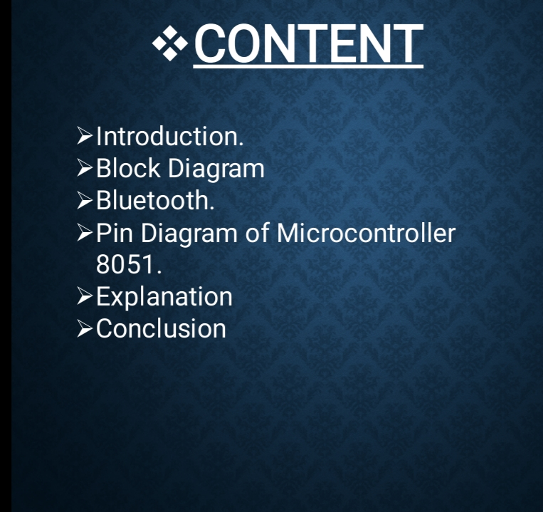

Slide 3
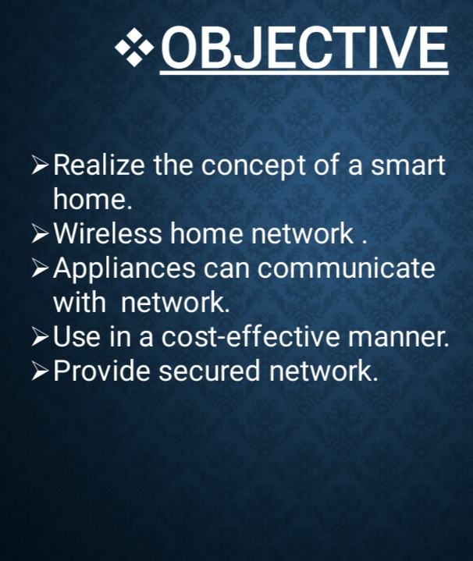

Slide 4
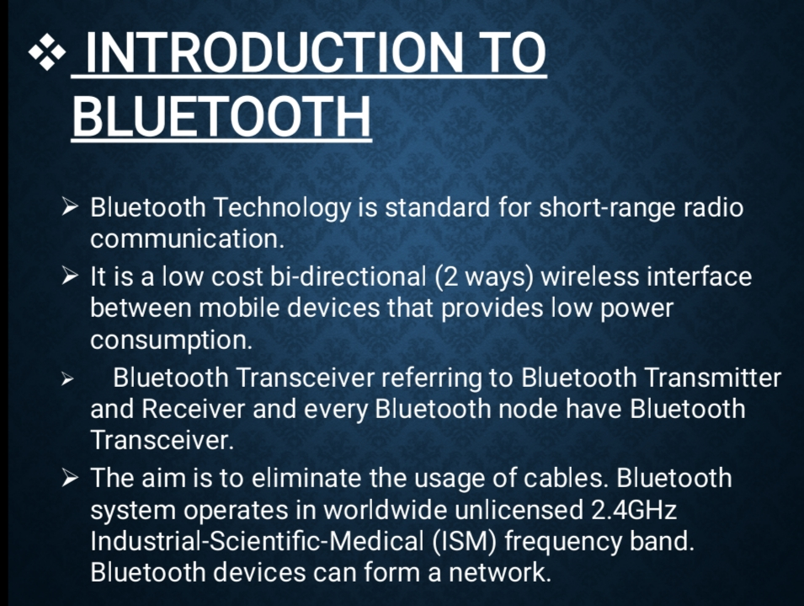

Slide 5
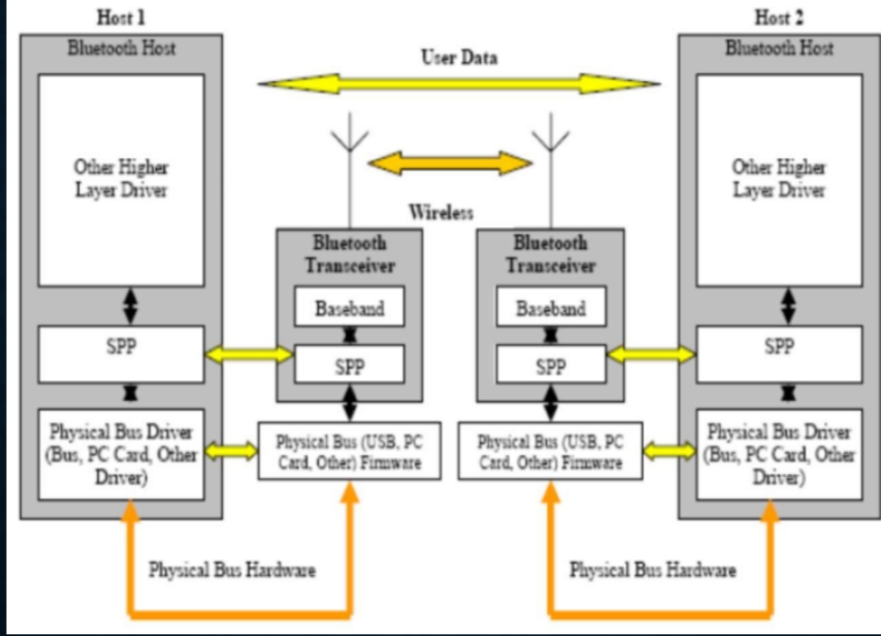

Slide 6
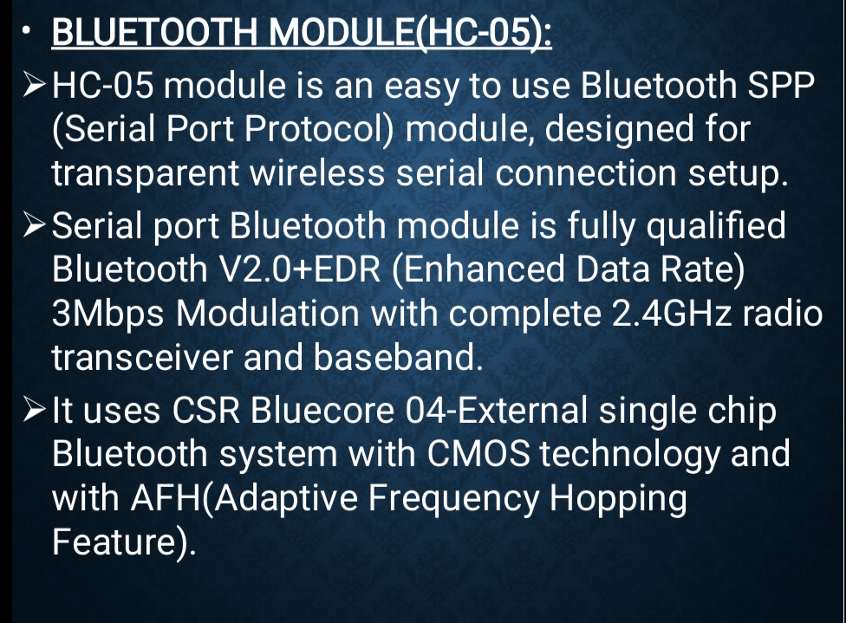

Slide 7
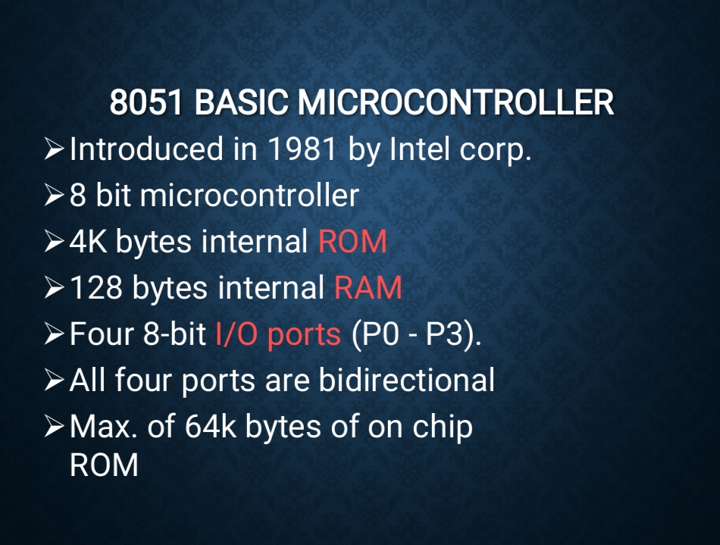

Slide 8
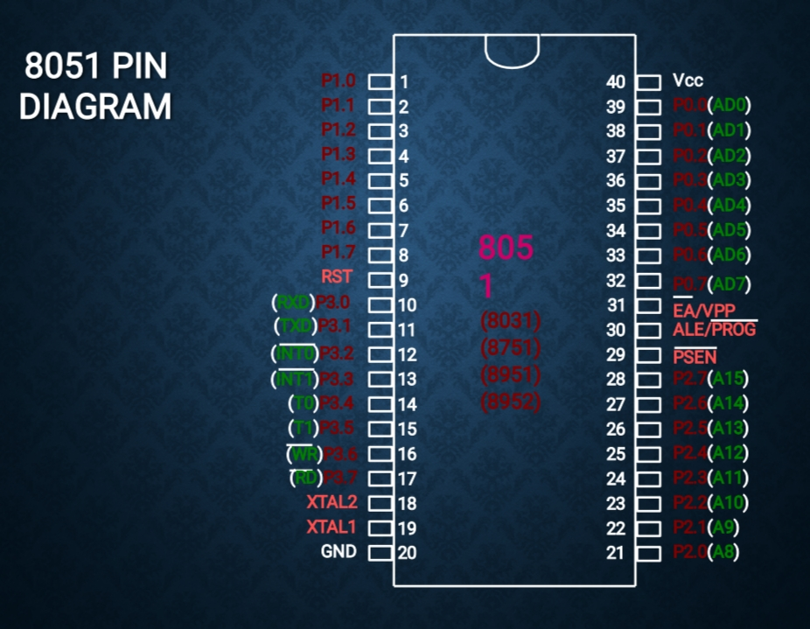

Slide 9


Slide 10
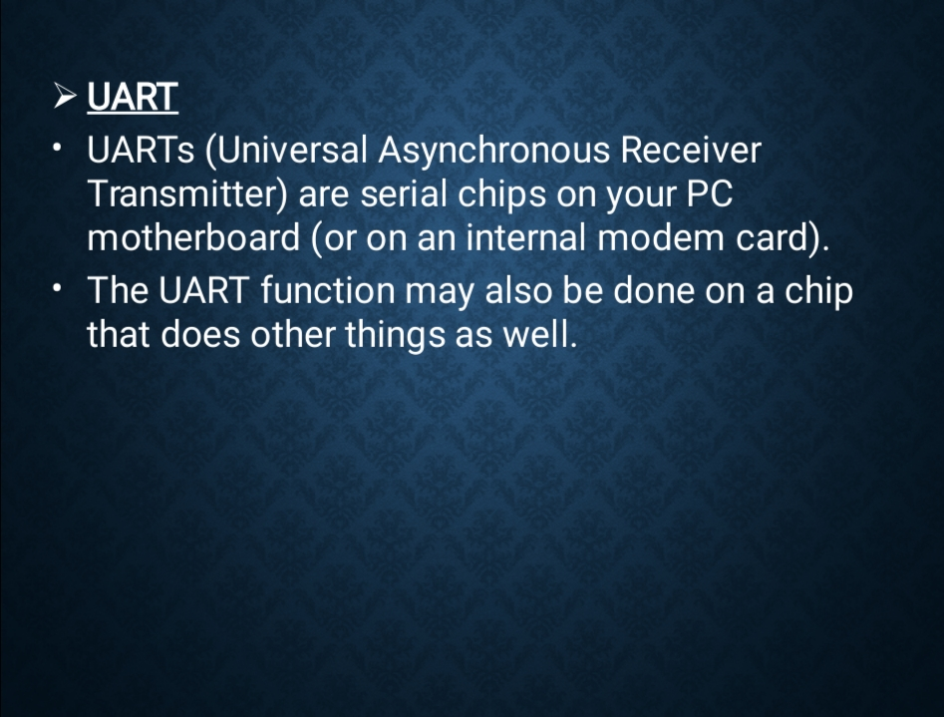

Slide 11
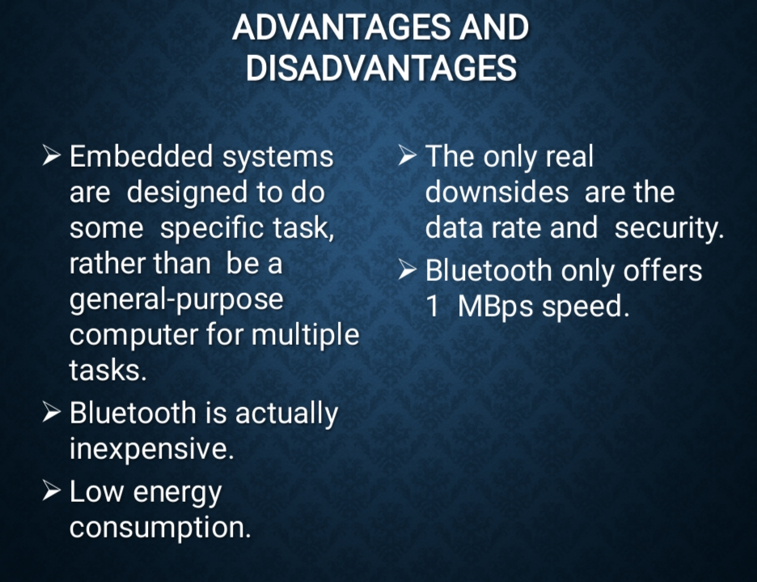

Slide 12
Reference:
www.electronicshub.org
www.engineersgarage.org

Slide 13
THANK YOU

