Slide 1


Subject Name : EC8652-Wireless communication Presentation Title: OFDM – A quick Overview
JEPPIAAR INSTITUTE OF TECHNOLOGY
“Self-Belief | Self Discipline | Self Respect”
Department of Electronics and communication Engineering
Team Members:
Students Name Reg.No:
1.Avil Anisha .A 210617106012
2.Asfiya naaz A.I 210617106011
3.Thilotaman.P 210617106080
4.Saravana Kumar 210617106071
5.Pradeep.S 210617106059
6.Murali.S 210617106053

Slide 2
Objective
To discuss the principles of OFDM
To explain Multicarrier Modulation

Slide 3
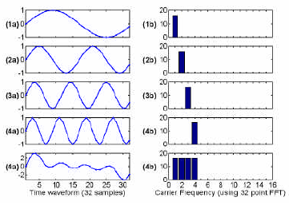
What is OFDM ?? Orthogonality in time domain…

Slide 4
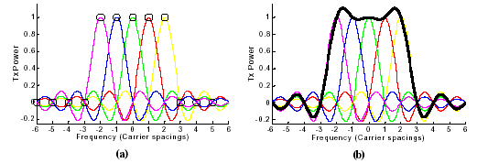
What is OFDM ?? Orthogonality in frequency domain…

Slide 5
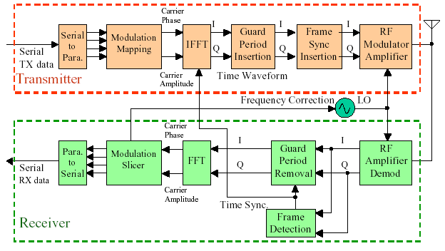
OFDM METHODOLOGY

Slide 6
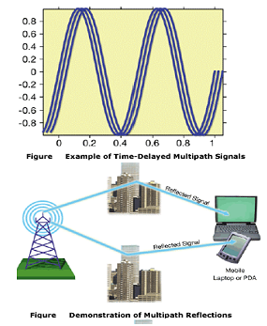
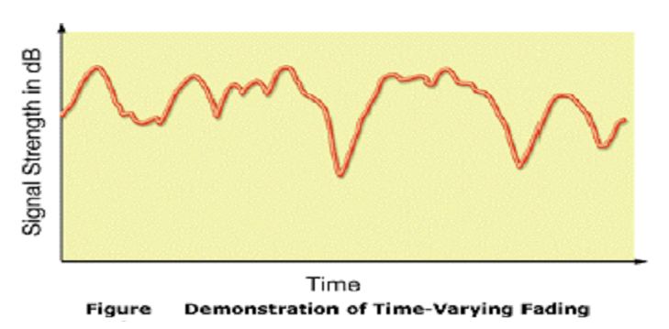
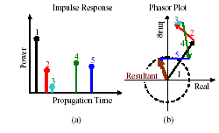
Understanding Multipath

Slide 7
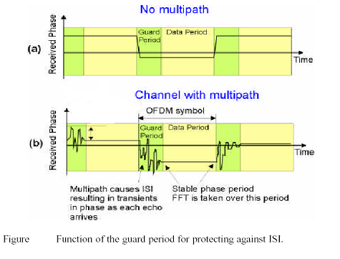
Why we need the Guard Period…

Slide 8
Advantages of OFDM
Allows carriers to overlap (no guard band), resulting in lesser wasted bandwidth without any Inter Carrier Interference (ICI)
High data rate distributed over multiple carriers resulting in lower symbol rate (more immune to ISI)
Permits higher data rate as compared to FDM
Increased security and bandwidth efficiency possible using CDMA – OFDM (MC-CDMA)
Simple guard intervals make the system more robust to multipath effects.

Slide 9
Applications
To PC file transfer using the ubiquitous sound card
Digital audio broadcasting (DAB), wireless CD-quality sound transmission
Digital video broadcasting (DVB), specifically, digital terrestrial television broadcasting (DTTB)
Wireless LAPC N 802.11a
ADSL (asymmetric digital subscriber line), also called DMT (Digital Multi Tone)

Slide 10
Reference
http://www.slideshare.net
http://www.electronicsnotes.com
http://www.sciencedirect.com

