Slide 1

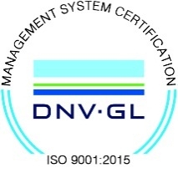
Subject Name : EC8652- WIRELESS COMMUNICATION
Presentation Title: Real time application of FDMA
JEPPIAAR INSTITUTE OF TECHNOLOGY
“Self-Belief | Self Discipline | Self Respect”
Department of Electronics and communication Engineering
Team Members:
Students Name Reg.No:
1. TONIE RAALPH .C 210617106081
2. ALWIN REVANTH.P 210617106007
3. KRISHNA KUMAR.S 210617106050
4. SANGAVI.L 210617106070
5. SURYA PRABHA.S.V 210617106078

Slide 2
Objective
To discuss the real time application of FDMA and its scope.

Slide 3
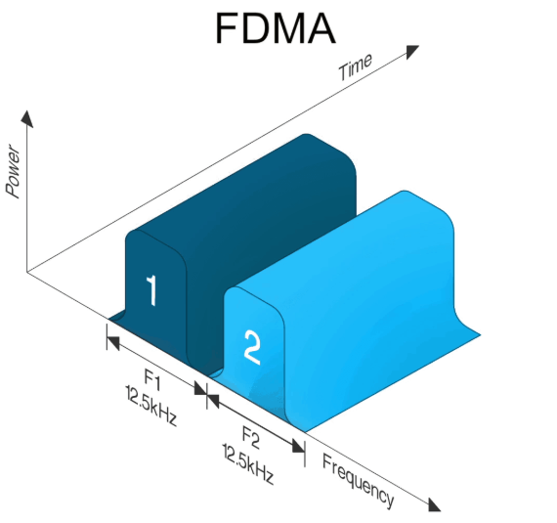
What is FDMA?
Frequency division multiple access (FDMA) is a channel access method used in some multiple-access protocols.
FDMA allows multiple users to send data through a single communication channel, such as coaxial cable or microwave beam, by dividing the bandwidth of the channel into separate non-overlapping frequency sub-channels and allocating each sub-channel to a separate user.
Users can send data through a sub-channel by modulating it on a carrier wave at the sub-channel's frequency.
It is used in satellite communication systems and telephone trunk lines.

Slide 4
HOW FDMA WORKS ?
FDMA is implemented at the media access control (MAC) layer of the data-link layer in the Open Systems Interconnection (OSI) reference model for networking protocol stacks.
FDMA is based on the frequency-division multiplexing (FDM) technique used in wireless networking.
In FDMA, the user is assigned a specific frequency band in the electromagnetic spectrum, and during a call that user is the only one who has the right to access the specific band.
In the AMPS cellular phone system, these frequency bands are allocated from the electromagnetic spectrum as follows:
Transmission by mobile station: 824 MHz to 849 MHz
Transmission by base station: 869 MHz to 894 MHz

Slide 5
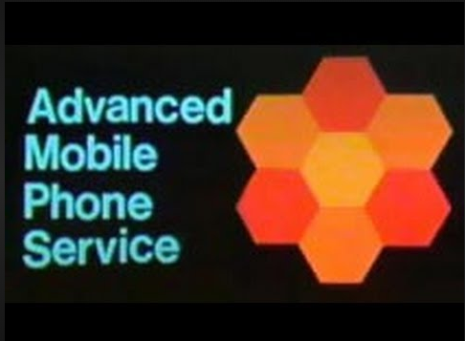
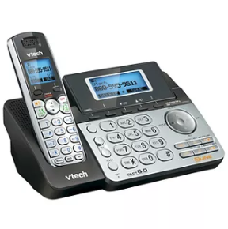
AMPS and DAMPS
FDMA is a basic technology in the analog Advanced Mobile Phone Service (AMPS), the most widely-installed cellular phone system installed in North America. With FDMA, each channel can be assigned to only one user at a time. FDMA is also used in the Total Access Communication System (TACS).
The Digital-Advanced Mobile Phone Service (D-AMPS) also uses FDMA but adds time division multiple access (TDMA) to get three channels for each FDMA channel, tripling the number of calls that can be handled on a channel.

Slide 6
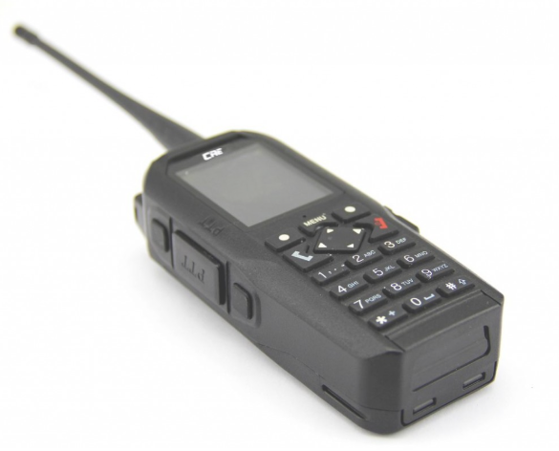
FDMA in WALKIE TALKIES
Early cellular telephony mostly used FDMA analogue transmission. Walkie talkies and mobile networks for closed user groups often use FDMA
F-600A as a universal digital communication product developed by Creation , this two-way radio utilizes leading FDMA technology and features digital-analogy compatibility
Frequency division digital relay station to ensure extensive coverage ( auto switch between relay/direct connection )
Low energy consumption and ultra long stand-by time

Slide 7
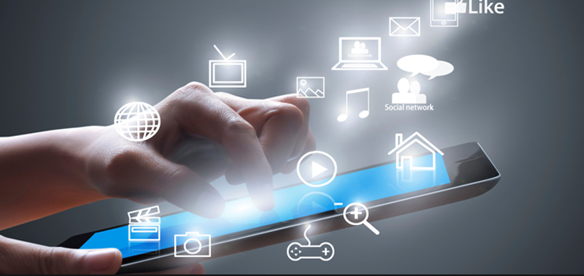
Communication access technique through
FDMA
It is the operation of splitting a single channel or bandwidth into several bands of frequency.
In this channel access scheme, every user gets a separate sub-band of frequency like in FM radio.
In this system, the user transmits data onto different frequencies at the same time.
It enables many users to transmit at the same time but using different frequency channels.
It is necessary to keep the channel wider, to accept the signal spectra of the conveyance to propagate.
FDMA is less complicated than TDMA, and it implemented in the narrowband system.

Slide 8
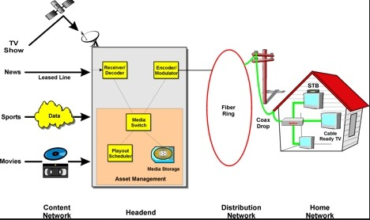
FDMA in cable television system
The medium is a single coax cable that is used to broadcast hundreds of channels of video/audio programming to homes.
The coax cable has a useful bandwidth from about 4 MHz to 1 GHz.
This bandwidth is divided up into 6-MHz wide channels. Initially, one TV station or channel used a single 6-MHz band.
But with digital techniques, multiple TV channels may share a single band today thanks to compression and multiplexing techniques used in each channel.

Slide 9
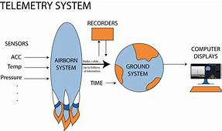
AEROSPACE TELEMETRY SYSTEM
Original aerospace telemetry systems used an FDMA system to accommodate multiple sensor data on a single radio channel.
Early satellite systems shared individual 36-MHz bandwidth transponders in the 4-GHz to 6-GHz range with multiple voice, video, or data signals via FDMA.
Today, all of these applications use TDMA digital techniques.

Slide 10
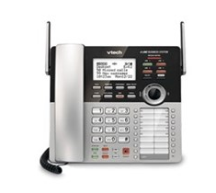
ANALOG TELEPHONE SYSTEM
One of the older FDMA systems is the original analog telephone system, which used a hierarchy of frequency multiplex techniques to put multiple telephone calls on single line.
The analog 300-Hz to 3400-Hz voice signals were used to modulate subcarriers in 12 channels from 60 kHz to 108 kHz.
Modulator/mixers created single sideband (SSB) signals, both upper and lower sidebands.
These subcarriers were then further frequency multiplexed on subcarriers in the 312-kHz to 552-kHz range using the same modulation methods.
At the receiving end of the system, the signals were sorted out and recovered with filters and demodulators.

Slide 11
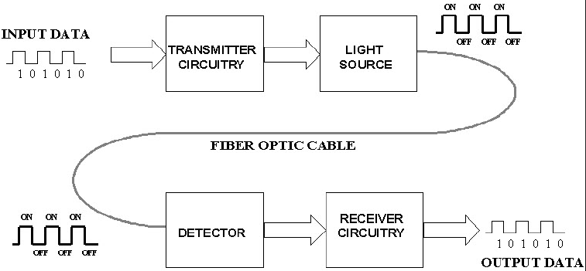
FIBER OPTIC COMMUNICATION
This technique is also used in fiber optic communications systems.
A single fiber optic cable has enormous bandwidth that can be subdivided to provide FDMA.
Different data or information sources are each assigned a different light frequency for transmission.
Light generally isn’t referred to by frequency but by its wavelength (λ).
As a result, fiber optic FDMA is called wavelength division multiple access (WDMA) or just wavelength division multiplexing (WDM).

Slide 12
COLLISION IN NETWORK
This techniques are used in networks when there is collision that is there is only on medium for sending data which is share among more than 2 devices,
Example when 2 mobile set wants to communicate the only interface is the air so if both of them work with the same frequency and send data at the same time there data collide.
So you can use TDMA or FDMA for the first for one period of time on of them send and another period of time the second.
Or we can use more than 1 frequency that is every of this devices use a different frequency which is the FDMA.

Slide 13
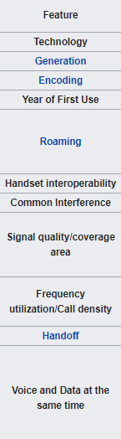
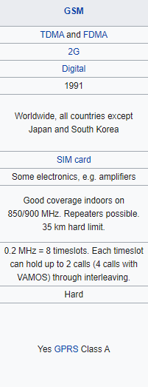
FDMA IN GSM

Slide 14
ADVANTAGES OF FDMA
AS FDMA systems use low bit rates(large symbol time)compared to average delay spread, it offers the following advantages-
Reduces the bit rate information and the use of efficient numerical codes increases the capacity
It reduces the cost and lowers the inter symbol interference (ISI)
Equalization is not necessary
An FDMA system can be easily implemented. A system can be configured so that the improvements in terms of speech encoder and bit rate reduction may be easily incorporated.
Since the transmission is continuous , less number of bits are required for synchronization and framing.

Slide 15
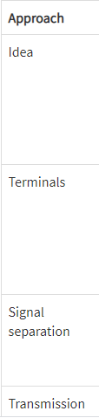
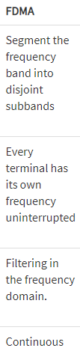
APPROACH OF FDMA

Slide 16
Reference
1. Wikipedia
2. www.epubs.surrey.ac
3. www.researchgate.net

