Slide 1


Subject Name :WIRELESS COMMUNICATION Presentation Title : Underwater communication implementation with OFDM
JEPPIAAR INSTITUTE OF TECHNOLOGY
“Self-Belief | Self Discipline | Self Respect”
Department of Electronics and communication Engineering
Team Members:
Students Name : Reg. No:
1.Divya S 210617106028
2.DIVYASHREE A 210617106029
3.DOMINIC P 210617106030
4.BALAJI S 210617106013
5.ANBIN D MESACH 210617106009
6.DIVYA M 210617106026

Slide 2
OBJECTIVE
.
How OFDM finds its suitability for wireless underwater communication.
The wireless underwater communication with OFDM scheme was tested using underwater transducers in a water tank and the results are presented.

Slide 3
INTRODUCTION
The Orthogonal Frequency Division Multiplexing (OFDM) is an emerging technology in wireless communication for high data rates.
Many wireless standards (Wi-Max, IEEE802.11a, LTE, DVB) have adopted the OFDM technology as a mean to increase future wireless communications requirements .
OFDM has already been proved to be an efficient modulation technique for land based communication systems, efforts are being made for using this technique for underwater communication.
Underwater channel is a time varying multipath channel causing Inter Symbol Interference (ISI), Inter Carrier Interference (ICI) and fading.
achieving high data rate in underwater wireless communication is challenging.

Slide 4
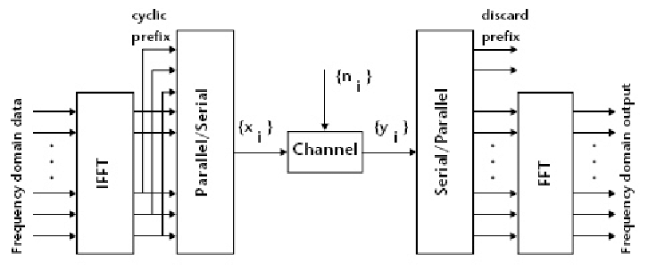
Orthogonal frequency division multiplexing (OFDM)
principle of OFDM:
It uses multiple orthogonal sub-carriers for data communication.
The data stream is sent over a range of sub-carriers after multiplexing, transmitting the data simultaneously over a number of different carriers.
OFDM functional blocks

Slide 5
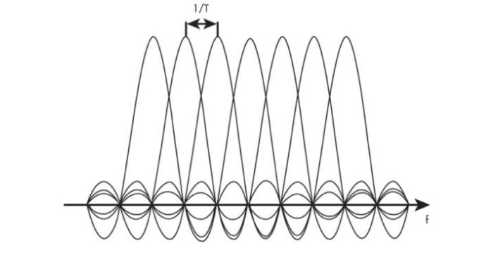
Each subcarrier carries a portion of the data. Depending on the number of sub-carriers used higher data rates can be achieved without getting affected by the channel distortions.
ORTHOGONALITY
Orthogonality in frequency domain

Slide 6
Orthogonal:
Two or more multiple objects act independently; in this case any neighbor signals in OFDM operate without dependence on, or interference with one another.
Explanation:
When the signal reaches its peak, the highest point and its neighbor signals will be at their 0 point or at null point. Therefore, orthogonal means signals are multiplexed .
Cyclic prefix
Guard time without cyclic prefix signal results in crosstalk between different subcarriers, causing the problem of Inter carrier Interference (ICI) and the subcarriers are no longer orthogonal to each other.

Slide 7
OFDM advantages
The limited underwater acoustic bandwidth can be utilized efficiently by the use of OFDM.
OFDM makes efficient use of the spectrum by allowing overlap between sub-carriers.
Introduction of guard time with cyclic prefix reduces inter symbol interference and inter carrier interference significantly and hence the modulation scheme is robust against ISI and ICI.
It is computationally efficient by using IFFT and FFT techniques to implement the modulation and demodulation functions respectively.
Besides being more suitable to overcome frequency selective fading and multi-path effects, OFDM also has implementation advantages, such as avoiding ISI and ICI, over other multi-carrier communication schemes.

Slide 8
Underwater communication
Underwater acoustic channel propagation is influenced by three major factors, attenuation that increases with signal frequency, time-varying multipath propagation and low speed of sound (1500 m/s).
Underwater acoustic propagation is best supported at low frequencies.
Since attenuation increases with frequency, for long range communication low frequency band only can be used, this in turn reduces the channel capacity.
Noise domination is more in low frequencies and decays with increase in frequency.
Doppler spread
Doppler spread is caused due to the random
motions of sea surfaces and currents.
The resultant Doppler spread is expected to be larger than that of the overall Doppler spread.

Slide 9
Experiments and Results
OFDM communication scheme
BER vs. SNR

Slide 10
The communication scheme was developed in MATLAB and the same was tested with simulated inputs.
The simulation test was repeated with introduction of AWGN of various levels in the transmitted signal.
To test the OFDM communication scheme in wireless underwater environment an experiment was conducted in a water tank of dimension 16 m × 9 m × 7 m .
Under water projector and receiver hydrophone were used for transmission and reception of signal respectively.
The transducers were held facing each other at a depth of 3.5 m and separated by 4.5 m apart.
Underwater test setup

Slide 11
CONCLUSION
OFDM is an efficient modulation scheme for high bit rate underwater communication.
The bandwidth efficiency of the scheme can be improved by the use of 8 PSK or QAM for sub-carrier modulation.
Forward Error Correction (FEC) coding and interleaving will make the system more robust against the channel distortion.
Application of Diversity techniques will further improve the performance of the communication system against the fading channel impairments.

Slide 12
Reference
1. Cimini J.L., Analysis and simulation of a digital mobile channel using orthogonal frequency division multiplexing. IEEE Trans. Commun., 33(7) (1985): 665–675.
2. Polprasert C., Ritcey J., and Stojanovic M., Capacity of OFDM Systems over Fading Underwater Acoustic Channels. IEEE J. Ocean. Eng. 36(4) (2011).
3. Li B., Zhou S., Stojanovic M., Freitag L., and Willett P., Multicarrier communication over underwater acoustic channels with nonuniform Doppler shifts. IEEE J. Ocean. Eng. 33(2) (2008): 198–209.
4. Milica Stojanovic, Underwater Acoustic Communication Channels: Propagation Models and Statistical Characterization. IEEE Communications Magazine (January 2009).
5. Kim B-C. and Lu I-T., Parameter study of OFDM Underwater Communications System. in Proc. IEEE Oceans’00 Conf., (Sept. 2000).

