Slide 1


JEPPIAAR Institute Of Technology
Self Belief | Self Discipline | Self Respect
Department Of Electronics And Communication Engineering
Subject: Wireless Network
Title: Wireless Application Protocol (WAP)
Name Reg.No
Yuvaraja.K 210617106090
Jayakumar.D 210617106043
Jagadeesan.K 210617106041
Hariprasath.V 210617106037
Inbensiya.R 210617106039
India.B.S 210617106040
Karthiga.R 210617106045

Slide 2
Overview
Wireless Application Protocol
WAP: Main Features
WAP Architecture
World-Wide Web Model
WAP Model
Advantages of WAP
Disadvantages of WAP
Conclusion
Reference

Slide 3
Wireless Application Protocol
♦ Wireless Application Protocol commonly known as WAP is used to enable the access of internet in the mobile phones or PDAs.
♦ An open, global specification that empowers mobile users with wireless devices to easily access and interact with internet information and services instantly.

Slide 4
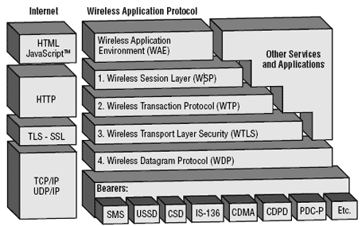
WAP Architecture :
Leverage existing standards whenever possible
Define a layered, scaleable and extensible Architecture
Support as many wireless networks as possible
Optimize for narrow-band bearers with high latency

Slide 5
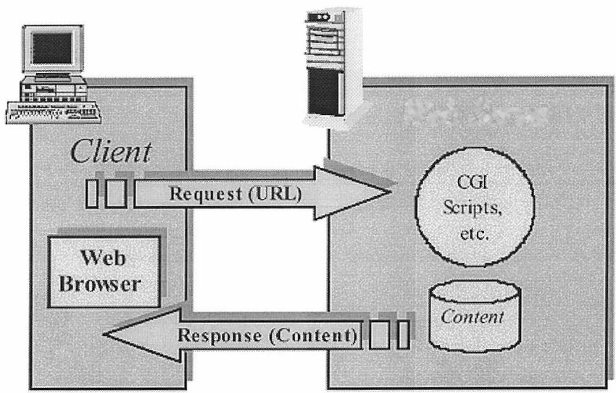
World Wide Web Model:

Slide 6
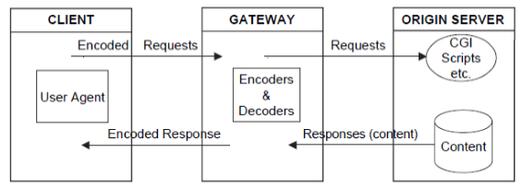
WAP Programming Model:

Slide 7
ADVANTAGES:
Implementation near to the Internet model.
Most modern mobile telephone devices support WAP.
Real-time send/receive data; Multiplatform functionality (little change is needed to run on any web site since XML is Used).
No hardware obsolescence.

Slide 8
DISADVANTAGES:
Low speeds, security, and very small user Interface.
Not very familiar to the users.
Business model is expensive.
Forms are hard to design.
Third party is included.

Slide 9
CONCLUSION:
In conclusion, WAP is suitable for the creation of mobile learning training course material.
The optimization of WAP and the handling of the design challenges makes it feasible to use mobile handheld devices for distance learning in real-time.
The application developer must always be aware of the user and take into account the usability issues if the application is to be a success.

Slide 10
REFERENCE:
[1]Joris Claessens. Analysis and design of an advanced infrastructure for
secure and anonymous electronic payment systems on the Internet.
PHD thesis, Katholieke Universiteit Leuven, December 2002. 220 pages.
[2] Tim Dierks and Eric Rescorla. The TLS Protocol Version 1.1. IETF
Internet Draft, March 2003.
[3] Ric Howell (Concise Group Ltd). WAP security.
http://www.vbxml.com/wap/articles/wap-security/default.asp.
[4] Open Mobile Alliance.
http://www.openmobilealliance.org/.
[5] Markku Saarinen. Attacks Against The WAP WTLS Protocol.
http://www.cc.jyu.fi/∼mjos/wtls.pdf.

Slide 11
Thank You!

